Slide 1
Montreal and McGill University are situated on the traditional territory of the Hauenosaunee and Anishnaabeg, a place which has long served as a site of meeting and exchange amongst nations.

Slide 2
What is the committee
Responsible for organizing events and programming
Facilitating collaboration with student and community groups
Overseeing the implementation of the Indigenous Solidarity Policy
Acting as a consultative body for the Indigenous Affairs Commissioner, the Executive Committee, and other staff and students.
Meet bi-weekly, are made up of Indigenous and non-Indigenous students

Slide 3
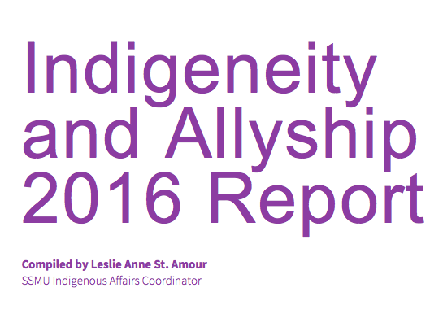
Important Documents
Indigenous Solidarity Policy
Indigeneity and Allyship 2016 Report

Slide 4
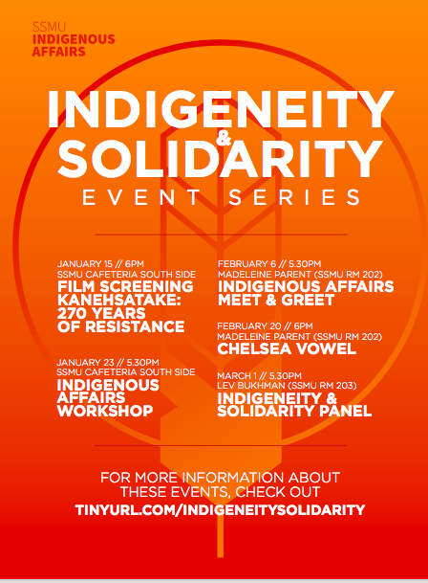
This years projects
Consultation & Solidarity 101
What is consultation and why does it matter
How to engage with Indigenous Issues
Land Acknowledgments: What and Why
Hosting Indigenous focused events
Collaborating with Indigenous student groups &/or profs
Solidarity Policy – What it means for you
Indigenizing the academy – what to know
Indigeneity & Solidarity Event Series

Slide 5
“Consultative body”
Open to collaborations
There to take questions
Shared networks/contacts

