Slide 1
President Mid-Year Report
15th of January, 2015

Slide 2
Outline
Completed and future structure
Projects
By-Law revisions
Judicial Board
GA
SSMU HR
Sustainability
McGill
Other

Slide 3
By-Law Revisions
Completed
Articles from Constitution moved into By-Laws
Nominating Committee role and responsibilities
By-Law Review Commissioners! And By-Law Review Committee
Future
Judicial Board role and responsibilities
Board of Directors over summer
VP External and VP C&S By-Laws
General redraft
Legal review of By-Laws and Constitution

Slide 4
Judicial Board
Completed
Minimum quorum met (2 law, 1 non-law)
Simakov vs. SSMU Executives case
Khan and Ali Syed vs. SSMU Council and Speaker case
Future
Role and responsibilities of Jboard
Quorum requirements with law students
Currently need 4 semesters of law to be eligible to sit on the Jboard as a Law Justice
Working with By-Law Review Commissioners and Committee

Slide 5
General Assembly
Fall GA
Peer support volunteers
~850 students
Safety and security of students / space
Winter GA
March instead of February
Looking for a larger space
Fieldhouse / gym
Leacock rooms and Moyse hall
Hotels and event spaces within 1 block of campus
Will need volunteers!

Slide 6
SSMU HR
Completed
Future
SSMU Staff Mental Health Policy
GM hiring
Student staff (hiring/supervision)
Secretary General GA
Secretary General Governance and Administration
Speaker
Parliamentarian
Recording Secretary
Environment Commissioners (2)
Green Events Coordinator
Green Building Coordinator
Ethics Commissioner
Elections SSMU (4)
By-Law Review Commissioner (2)
Sustainability Research Coordinator
GM training
CEO+DEO hiring
Student staff 2015-2016 hiring
May transition of executives

Slide 7
Sustainability
Completed
Future
Environment Commissioners
Sustainability Assessment and SPOKES Conference
Green Events Coordinator
Workshop and green events guide
Green Building Coordinator
Utilities report to council
Sustainability Research Coordinator! And Ad Hoc Sustainability Committee
Consultation / survey
Research project
Environment Commissioners
Composting campaign
Green Building Coordinator
Reverse vending machines
Sustainability report and recommendations for future implementation coming to Council!
Edit Sustainability Policy

Slide 8
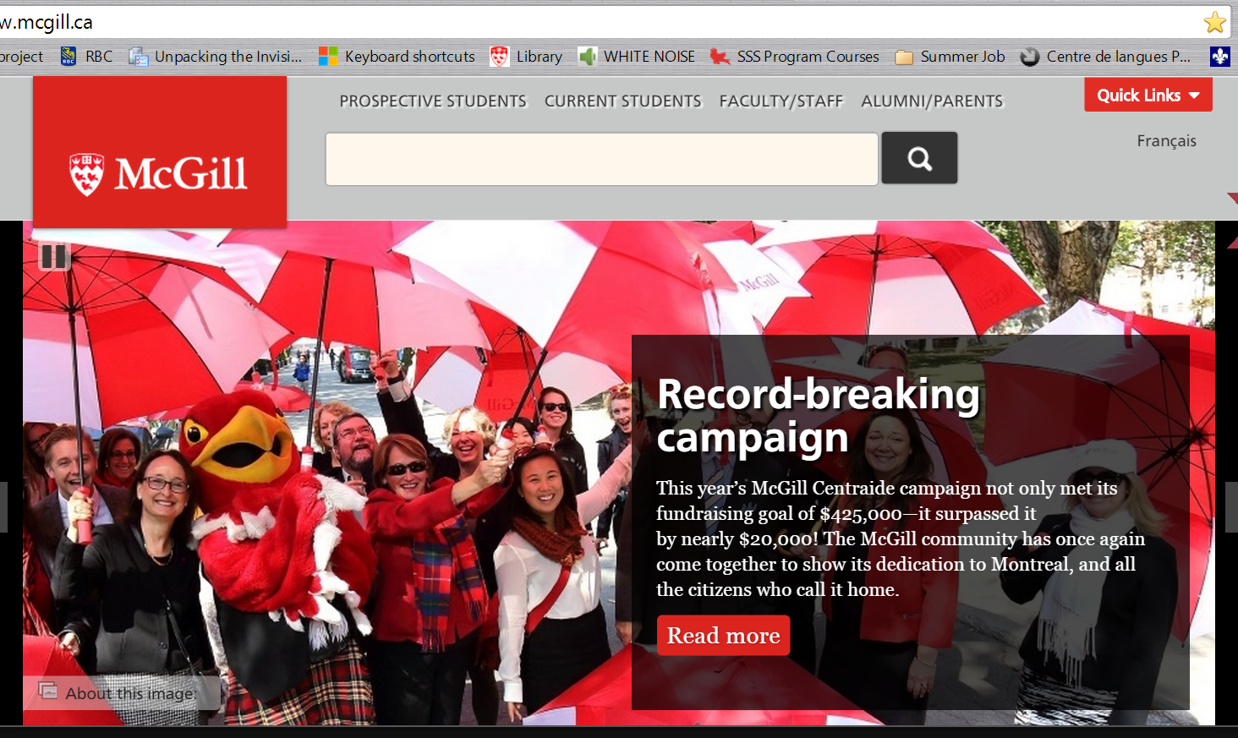
McGill
Completed
Centraide campaign
$444,000+ raised
Ongoing
Senate
Senate Committee on Physical Development (SCPD)
Academic Policy Committee (APC)
Board of Governors
Buildings Properties Committee (BPC)
Committee to Advise on Matters of Social Responsibility (CAMSR)

Slide 9
Other!
Completed
SEAMLESS
Council retreat orientation and equity training
Monthly media meetings
Future
SSMU + PGSS joint summit
Continuing media meetings
Office hours this semester: Mondays 11am-1pm

