Slide 1
You have a project idea for sustainability at McGill? “PUT A BIRD ON IT!”
February 12, 2015
Kim McGrath, SPF Steward & Sustainability Officer
McGill Office of Sustainability

Slide 2
The Precious and Fabulous SPF
3 key things to know about the SPF
Overview
Examples
Application Process
What is Next?

Slide 3
I. 3 key things to know about the SPF
Students-Admin. partnership since 2010
SPF Mandate: “Build a culture of sustainability on McGill campuses through the seed-funding of interdisciplinary projects.”
= developing and institutionalizing structures / processes / attitudes at McGill
that are more socially, environmentally, and/or financially responsible, this through implementing
collaborative and self-viable initiatives
Tool for co-learning and experimenting with the SPF stakeholders through iterative feedback and project-long commitment.

Slide 4
II. More on the SPF mandate
“Build a culture of sustainability at McGill through the seed-funding of interdisciplinary projects.”
Build a culture:
Change way things are done: Impact the structures/processes/systems to provoke a positive transformative and enduring change in ideas/assumptions/habits/behaviors.
… of sustainability:
recognizing the interdependence and complexity of systems, looking for minimum impacts and equilibrium and responsibility towards environmental integrity and social and economic justice.
… at McGill:
funded projects must be led by a current McGill staff or student
the project and the culture shift it encourages must impact first and foremost the McGill campuses and its direct stakeholders.

Slide 5
II. More on the SPF mandate
“Build a culture of sustainability at McGill through the seed-funding of interdisciplinary projects.”
… through seed-funding:
through helping kick start the project
= project should look for multiple financing avenues and eventually become financially self-
sufficient, i.e. viable without being subsidized
… of interdisciplinary projects.:
for coherence with sustainability, of projects that are thought through and embracing various perspectives, thus regrouping a diversity of members and stakeholders from different domains, background, profiles, etc.
= more comprehensive and enduring interventions
= higher ownership by the community since people relate to someone/something in the
project
= higher chances of success of the project

Slide 6
II. Overview
In sum, the SPF is not:
Easy money
Projects are to be thought out and managed with rigor, through fun but with care/attention.
Assessed against 9 Evaluation Criteria
Your team accompanied all along by the SPF Steward and the SPF Administrator as you prepare, submit, and conduct your project.
= project-long commitment, including monitoring, reporting, and mentoring.
A grant (i.e. grant vs fund)
$ saved and gradually attributed as you realize
For research or things that should normally be covered by other grants or by McGill regular operating budget.
To finance one-off initiatives that will not be institutionalized (culture building).
The SPF: Not easy and not a crutch, yet very exicting and rewarding!

Slide 7
II. Overview
In sum, the SPF is:
Your fund
A model of partnership and collaboration
An experiential learning and thus an empowering tool
An engagement tool, a tool for citizenship
Increasingly part of McGill’s identity
And so much more…
The SPF: A unique and precious resource to be treasured by everyone at McGill.

Slide 8
II. Overview
Since 2010, the SPF has been learning and maturing with its projects:
> 260 applications → > 141 projects
84% collaborative staff/students
On track with funds
30% connecting both Macdonald and downtown campus
Independent Review + 3-year Report for the 2010-2013 pilot years
Transparency and accountability a high priority
E.g. SPF Working Group Terms of Reference and webpage
More information to be provided to project teams upfront through various means
Reporting aligning with fiscal year → 2014 report to be presented in the fall
Update in application process and tools for project teams in order to provide help design aligned projects with maximum impact.

Slide 9
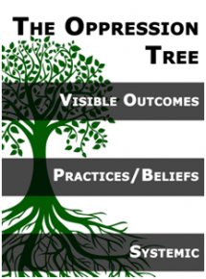
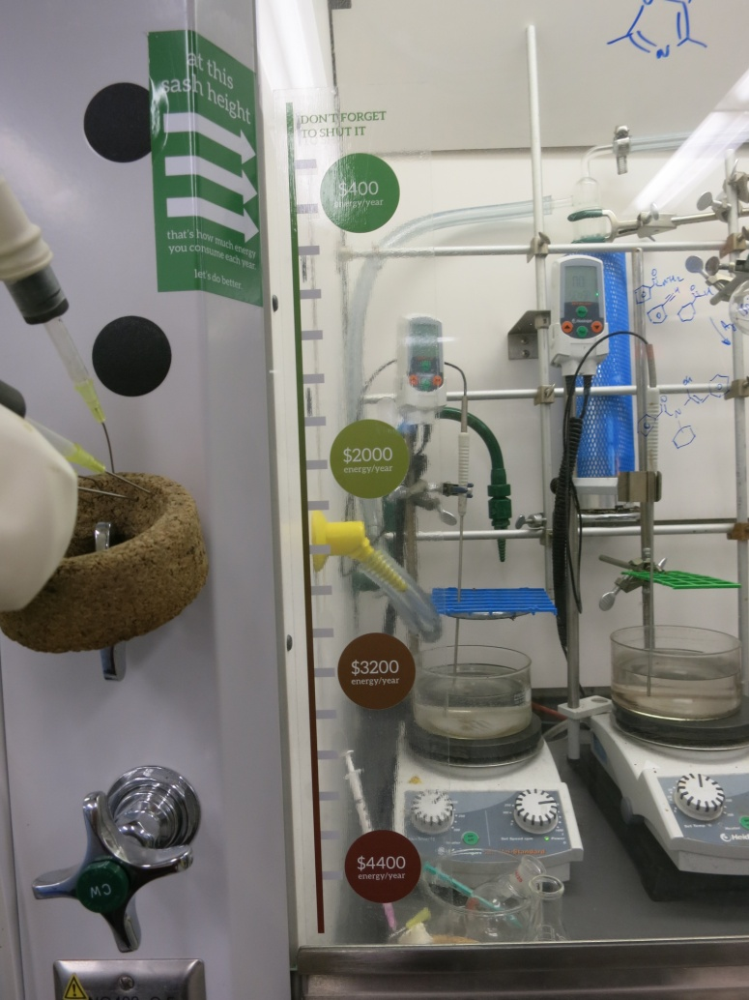
IV. Examples
Shut Your Sash
(SP0041 – 7.7K)
Residences Anti-Oppression
Programme (SP0126 – 60K)

Slide 10
Shut Your Sash (SP0041 – 7.7K)
McGill Issue: 1 open fume hood = yearly energy of 4 Canadian households = 3.5 trees to neutralize emitted GHG!
Goal: Campaign to educate and elicit a behavioral change concerning the use of chemical fume hoods within various McGill laboratories (Bellini and Goodman Cancer Centre).
Objective: Increase the awareness of the lab users and change their behaviour over the time of the SPF project.
Desired Impact/Outcome: Lower energy use and cost reductions within this building.
Activities:
Going from lab-to-lab explaining the issue and organized contest measuring the hood heights and offering pizza to the lab with the lowest height, using stickers/posters (‘Shut Your Sash’ campaign).
Some Results:
Yearly energy consumption of the building significantly reduced + project team spoke with over 250 persons, developing network.
Project lead spoke directly to over 250 members, still in contact with individuals about the campaign and the sashes were still found closed many months after the project was over.
McGill Health & Safety Services was involved, raising awareness during their mandatory fume hood safety sessions → to expand to more buildings on McGill campus.

Slide 11
Residences Anti-Oppression Programme
(SP0126 – 60K)
McGill Issue: 20% of students experiencing ‘somewhat to very much’ discrimination on any basis, whether due to language, race, ability, gender, etc. Particularly hard for 1st year students as they live transition to university.
Goal: Extending and nuancing their understandings of race, gender, ability, class, etc., equip 1st year resident students, live-in student staff and professional staff with the tools and knowledge to effectively and proactively address issues of discrimination and harassment as they arise.
Some Objectives: By May 2015, build-on existing anti-oppression training; compile and improve upon anti-oppression resources for all resident students & staff and make them permanently available; create a residence Equity Policy; develop an ‘Equity & Residence Life at McGill’ report template; etc.
Desired Impact/Outcome: Higher sensitivity to and lower number of discrimination and harassment issues/cases.
Activities: Trainings development and provision, workshops, discussion groups, movie screenings, etc.
Some Results:
All Residence Life staff and student staff received anti-oppression training prior to move-in.
Multiple staff were trained to deliver various trainings (Anti-Oppression 101, Inclusive Event Planning, etc.).
Rez Project expanding to include workshops on race and on mental health, these workshops also having been translated into French.
Coordinated with MyACCESS (from the Office for Students with Disabilities) and the McGill Writing Centre to provide service hours directly in residences.

Slide 12
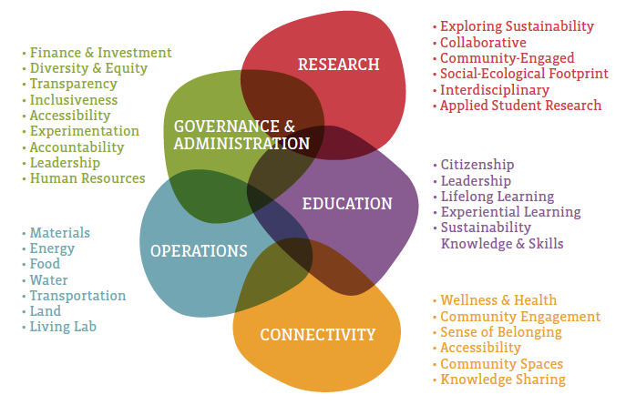
IV. Examples – More Ideas
Categories of the McGill Vision 2020 Sustainability Strategy
+ see list of SPF projects: www.mcgill.ca/sustainability/spf/current-projects

Slide 13
III. Application Process
You can apply whenever you want.
Plan a few weeks/months in advance.
Updated application tools online in March - contact me for starting by then: kim.mcgrath@mcgill.ca
2 STAGES:
‘Project Overview’
Basic team info + open Qs to verify that the project aligns a minimum with the criteria.
SPF Steward & SPF Administrator provide feedback and/or ideas where needed.
'Project Overview' modified if needed.
Then the SPF Steward & the SPF Administrator give the ‘go’ to Stage 2.

Slide 14
III. Application Process
‘Detailed Project Plan’
Objectives, Activities, Inputs (resources), Indicators, Risks, Timeline, Support Letters, etc. to specify project and verify that it still aligns a minimum with the criteria.
SPF Steward & SPF Administrator provide feedback and/or ideas where needed.
Detailed Project Plan modified if needed.
Once your entire application respects min. criteria specs, the SPF Steward & the SPF Administrator send it to the SPF Working Group, who assesses you project independently:
Reflecting the Students/Admin. partnership, 4 student + 4 staff members decide together by consensus.
Provide one of the following decision + qualitative feedback through a Feedback Letter: Project accepted, needs minor revisions, needs major revisions, rejected, or a Request for more information.

Slide 15
III. Why you should join
Occasion to:
Communicate and impact things that really matter to you.
Show that you care, making your environment better through your own initiative.
Try out something in a safe space, getting full support from SPF staff, having each idea and effort valorized and reinforced.
Work with people you would not have had a chance to work with otherwise.
Act as a mentor (e.g. methodology, project management, connecting with people).
Experience project management from A to Z and be able to report on this once graduated while gradually bridging to the workplace.
The SPF: A ton of opportunities and resources awaiting for you!

Slide 16
V. What is Next
Visit the McGill Office of Sustainability website: full of inspiring resources (e.g. see the Get Involved! section) and examples of SPF projects: www.mcgill.ca/sustainability
Brainstorm with people to refine your project idea that would improve sustainability at McGill:
Find various advocates for your idea.
Meet with and engage key leaders/decision-makers (remember: building a culture/creating a culture shift = key support and buy-in needed).
Refine your project idea with their feedback.
Contact the SPF staff to present your draft 'Project Overview': kim.mcgrath@mcgill.ca
While you have the ideas and knowledge about your projects, we are here to help you developing and realizing them by providing you various resources, among others…
Finalize your application through Stages 1 & 2.
Get funded ☺
Be a change agent, make a difference, leave your print at McGill…

Slide 17
THANK YOU!
www.mcgill.ca/sustainability
/McGill.Sustainability
@SustainMcGill
/McGillSPF
QUESTIONS
Kim McGrath, SPF Steward & Sustainability Officer
kim.mcgrath@mcgill.ca
(514) 398-8826

