Slide 1
BLACK STUDENTS’ NETWORK OF MCGILL
Legislative Council Presentation

Slide 2
The Black Students’ Network (BSN) is a service provided through the Student
Society of McGill University (SSMU), that is dedicated to addressing the
needs and interests of Black people but also all interested students
irrespective of race, culture or creed.

Slide 3
Our team is made up of 13 members consisting of 10 executive members filling the roles of:
President
VP Internal
VP Finance
VP External
VP Political
VP Media
VP Education
VP Advocacy
VP Social
First Year Representative
and 3 projects managers specifically for the Political, Advocacy and Social positions
At Palais des Congres to see Michelle Obama

Slide 4
MISSION STATEMENT
The BSN’s mandate is:
to promote the interests of Black peoples and to sensitize McGill University and the wider Montreal community to issues concerning these peoples.
to work towards making the McGill campus safe and accessible for black students in order to support their academic success as well as mental and physical well-being.
While dedicated to addressing the needs and interests of Black students, all interested students, irrespective of race, culture or creed, are encouraged to participate in the organization’s numerous events and activities.

Slide 5
Even though the world is progressing, some things stay the same. Institutional and systemic racism remains. McGill as an institution, is not free from issues, despite the many centuries that have passed since its establishment. Sometimes these problems are clear, and other times, they are not.
As the Black Students’ Network, we are committed to seeking out these issues and working to solve them. We are committed to the students who attend McGill and are affected by both individual and systemic issues.
Our goal is to create an environment where you can thrive and benefit from your University Experience.
Through all the good and the bad, the Black Students’ Network aims to always be at the sides of our fellow students in the McGill community.

Slide 6
HISTORICAL CONTEXT
Sir George Williams College Protests 1968
Founded in the 1970s
Children’s Day 1980s
Fighting Apartheid 1990s
Black and Africana Studies Program 1998
Africana Congress 2000
Soul Food Friday

Slide 7
What do we do?
Children’s Day since the late 1980s!
Organize panels, screenings, and symposiums!
Support initiatives:
  Dr. Philip S.S. Howard’s Arts Against Post-Racialism (AAPR)
  DABI conference at Desautels
  Black History Month
  For Colored Girls the first Black Production at McGill University!
  And many more!
Soul Food Friday!
Sit on various committees pertaining to equity such as the Subcommittee for Racialized and Ethnic students and SSMU Equity
Liaise with Associations, Clubs, other student and non-student groups on campus to centralize resources and not duplicate efforts!

Slide 8
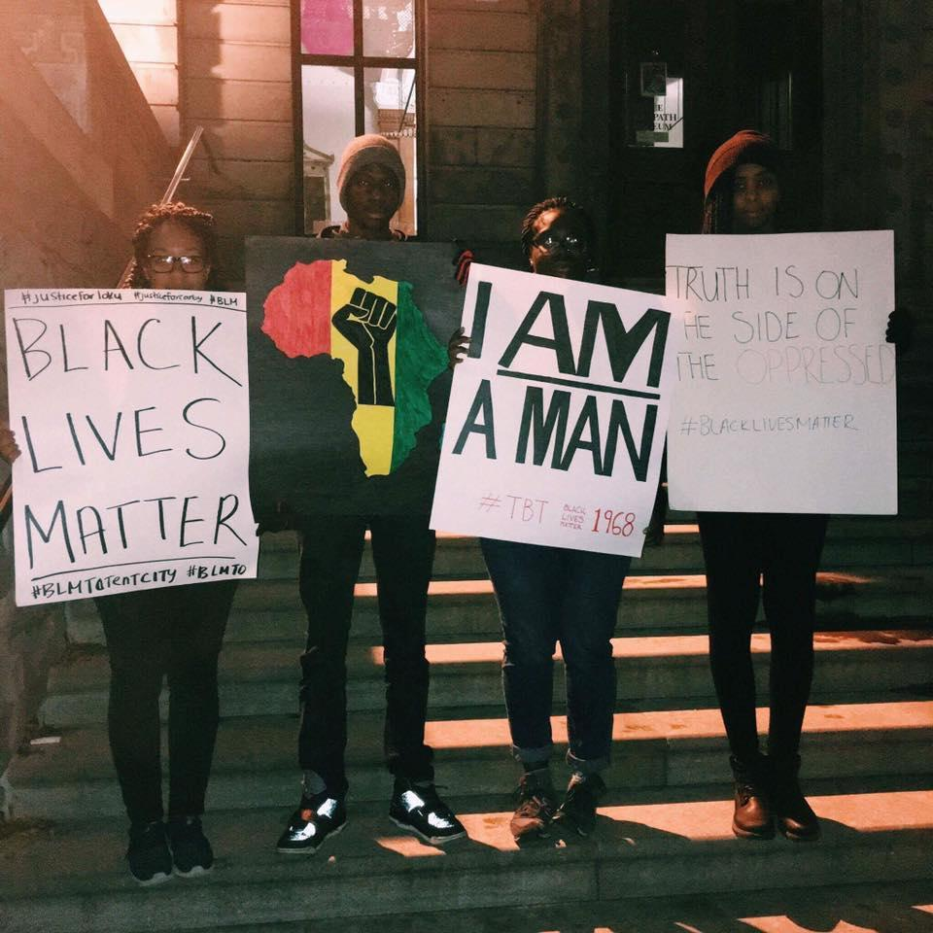
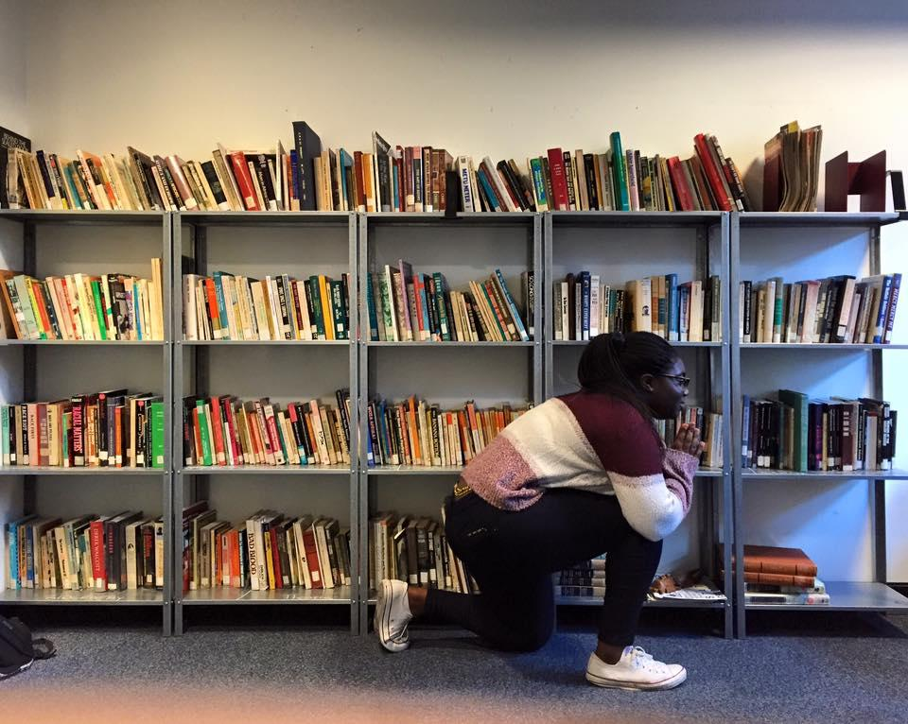
OUR EVENTS (in pictures)
Children’s Day 2014
BSN Library
Vigil on Police Brutality 2016
Panel discussion on Police Brutality 2014
BSN General Meeting

Slide 9
Soul Food Friday 2017
Hair Day 2016
For Colored Girls who have considered suicide when the rainbow is enuf
Fro-back Party 2015

Slide 10
COLLABORATIONS W/ ON-CAMPUS GROUPS
SEDE
QPIRG
MK
HEALTHY MCGILL
NSBE
MWIL
QUEER McGill
McGill Black Alumni Association
MASS
HE for SHE
DEMOCRATS ABROAD
CSS
BLSA
PGSS Equity and Diversity
ECOLE
ISA

Slide 11
WHY IS THERE A FEE INCREASE?

Slide 12
EXPANSION
Allow for more prestigious speakers to come to the McGill campus (e.g. Issa Rae, Michelle Obama, Dr. Kimberlé Crenshaw, Ta-Nehisi Coates)
Allow for more collaborations with other clubs and services both at McGill and in the great Montreal, Quebec, and Canadian community.
Children’s Day (costs of venue, food and transport have increased)
Conference or Symposium for Black Student Associations across Canada
Acquisitions for the BSN Library and support for the Reading/Media club such as theatre trips, movie trips and concerts
Information Handbook and Zine
Paying for event venues (especially since SSMU is closing) and SSMU fees.

Slide 13
2. SUPPORT
We have become an official main stakeholder for McGill’s Black History Month
Be able to support more student initiatives such as Plays, Fashion shows and Panel discussions
Self care and Mental Health support- retreats, seminars, workshops
BSN Hair Day

Slide 14
3. HUMAN RESOURCES
Salaries:
  Acknowledgement of labour put on by executive members over the years
  We want to be able to hire students to do small-scale projects (e.g. workshops, research, etc.)
  People with greater skills attracted to the roles thus producing better work
  Efficiency
  Institutionalization of our work so that it becomes easier for executives in the future
BSN is among the few SSMU services whose executive membership is not paid, this needs to change so we can ensure equity at McGill.

Slide 15
QUESTIONS?

Slide 16
THANK YOU!
please follow us on our social media (Facebook, Instagram, Tumblr)
check-out our new website: http://bsn.ssmu.ca/

