Slide 1
FIAT LUX: LET THERE BE LIGHT Reimaging the McGill Library for the 21st Century
Colleen Cook
Diane Koen

Slide 2
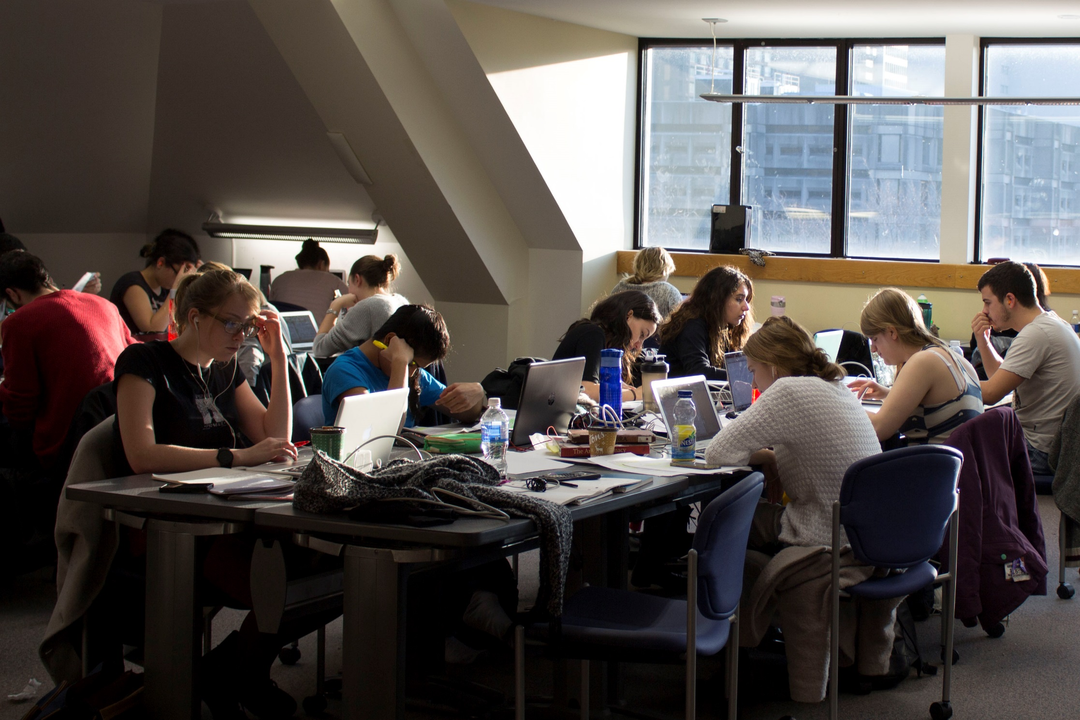

Slide 3
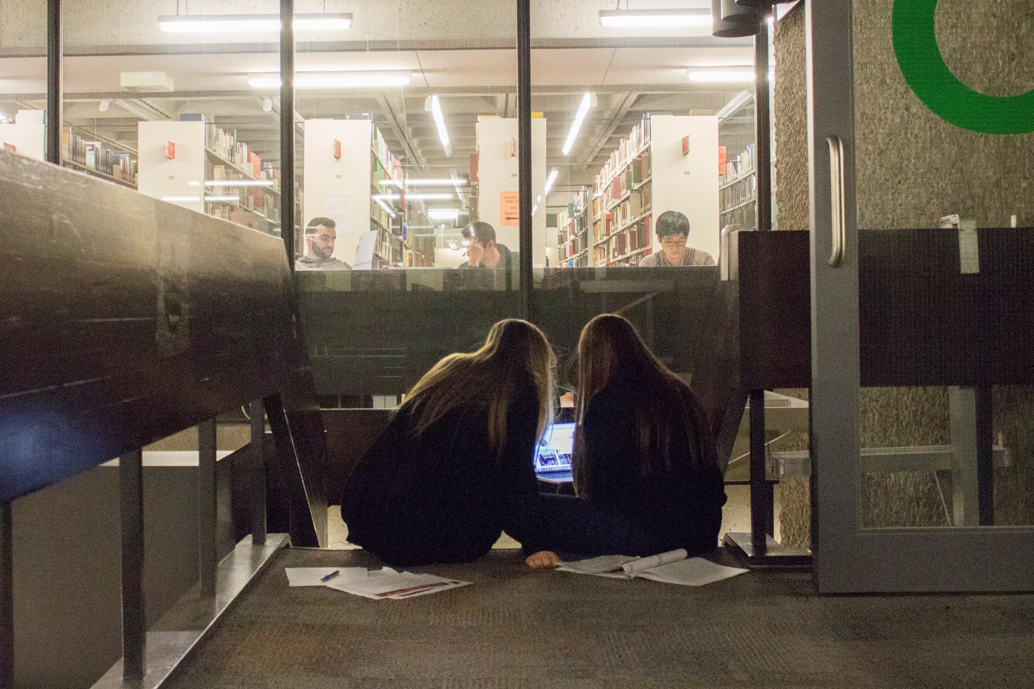

Slide 4
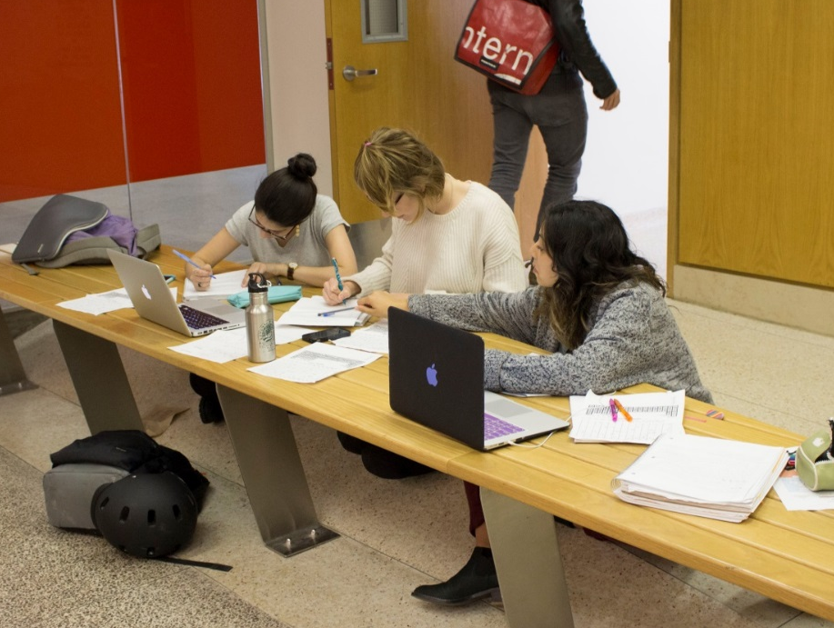
FORGING A CLEAR PATH: REDEFINING THE LIBRARY’S MANDATE
It has long been clear that the current library could not match the needs of modern students
In 2014, the library launched an exhaustive process to reimagine the McGill library for the mid-21st century
Investigation was done in partnership with the ekm and Shepley-Bulfinch architectural firms

Slide 5
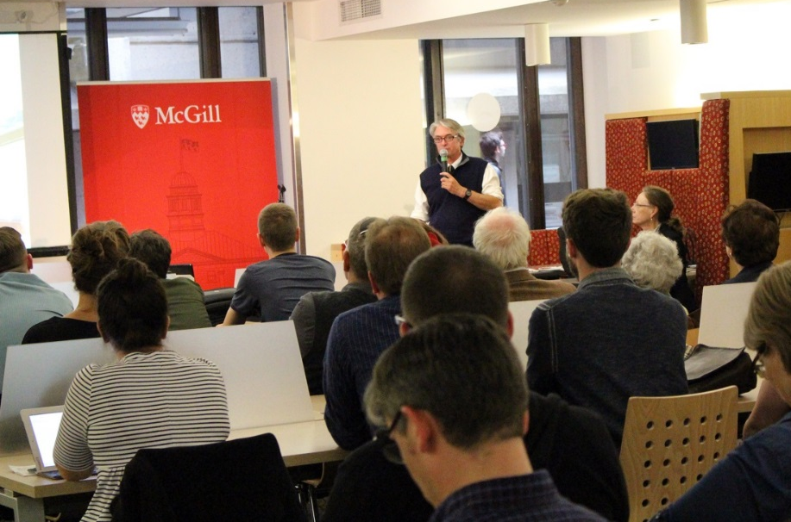
FORGING A CLEAR PATH: REDEFINING THE LIBRARY’S MANDATE
Information and feedback mechanisms included:
over a dozen site visits to pioneering academic libraries and spaces across north america
symposium on future of academic research libraries
student, staff and faculty focus groups
communication and steering committees with cross-campus membership

Slide 6
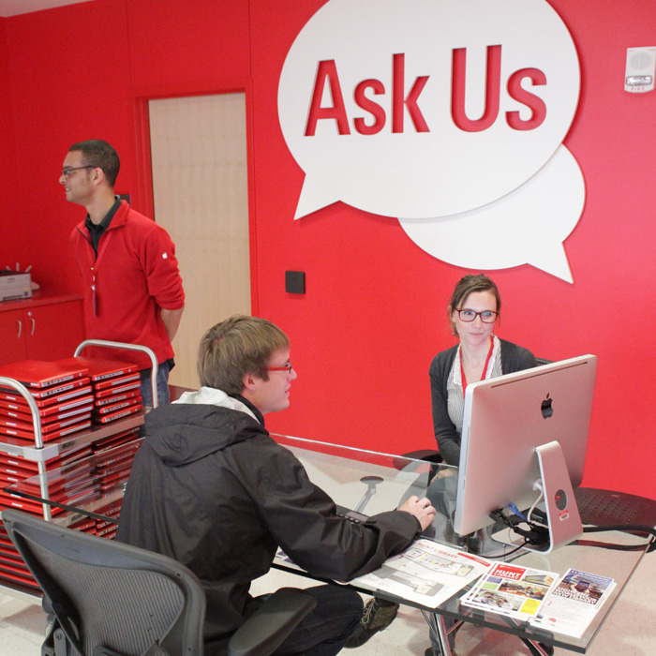
Fiat Lux Features
Librarians and staff onsite
Supporting students, researchers and faculty
“Eyes on the street”

Slide 7
Fiat Lux Features
Signature reading room
For quiet study
Formal events and gatherings

Slide 8
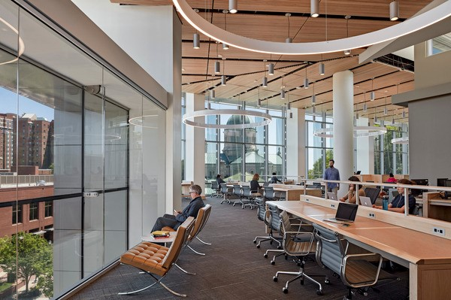

Slide 9
Fiat Lux Features
Small print collection
Focus on electronic access and support

Slide 10
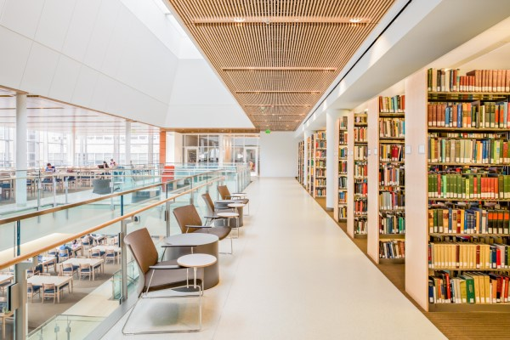

Slide 11
Fiat Lux Features
Range of formal and informal teaching and learning spaces throughout the complex
lecture theatres
small and large classrooms, active learning and traditional, as needed
seminar rooms
Supported by a range and mix of breakout rooms
group study rooms
group study zones
Informal and formal seating

Slide 12
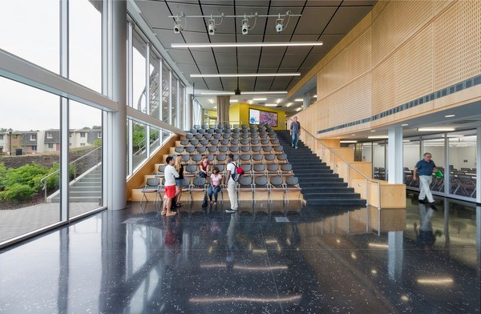

Slide 13
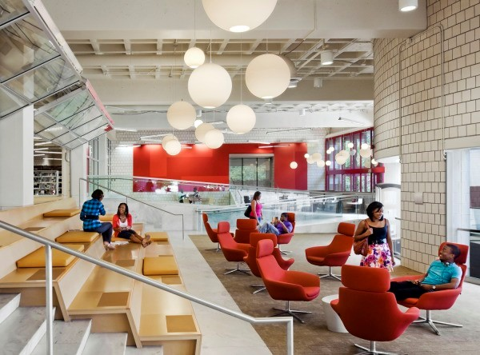

Slide 14
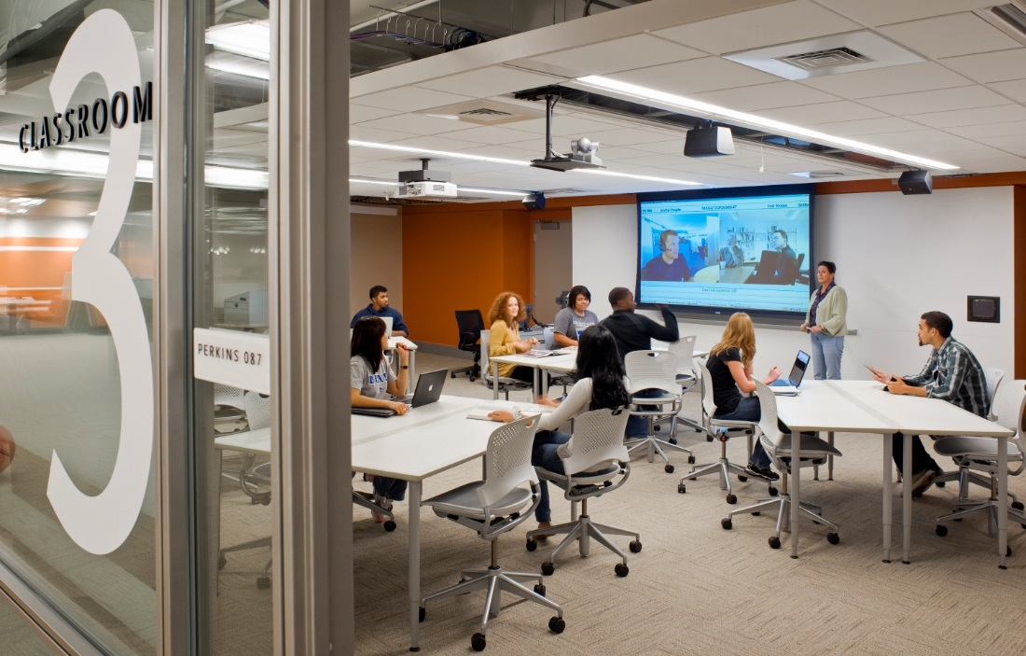

Slide 15
Fiat Lux Features
Collaboration spaces

Slide 16
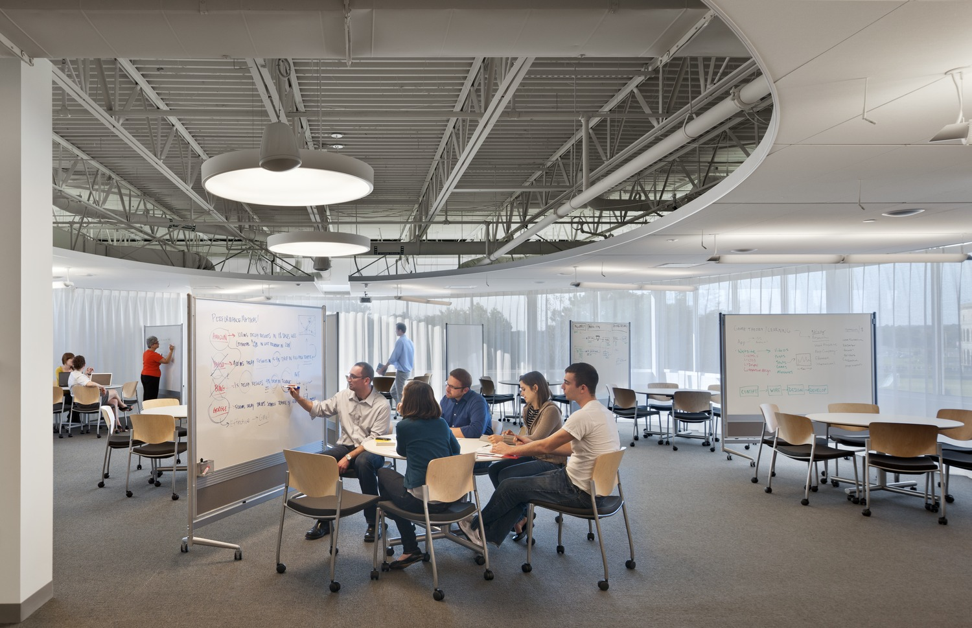

Slide 18
Fiat Lux Features
Everything flexible
To adapt to a changing pedagogical world
Variety and choice

Slide 20
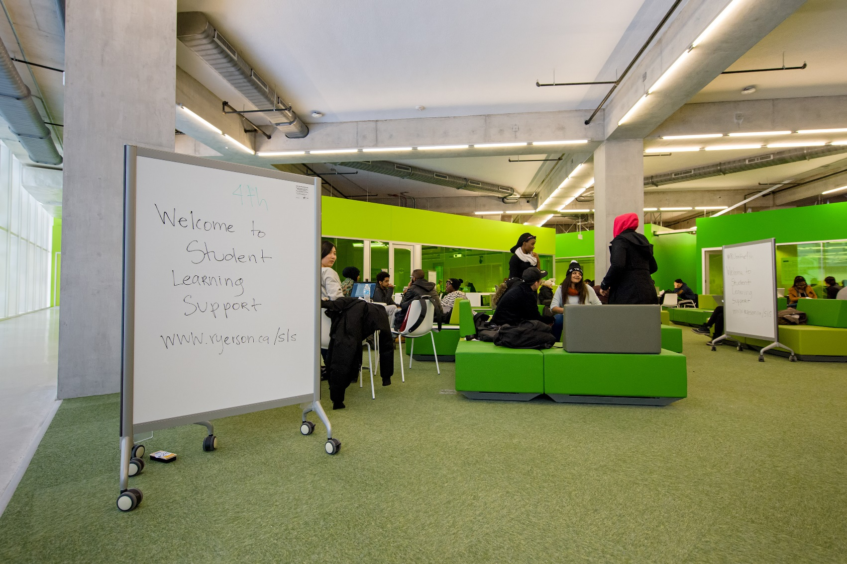

Slide 22
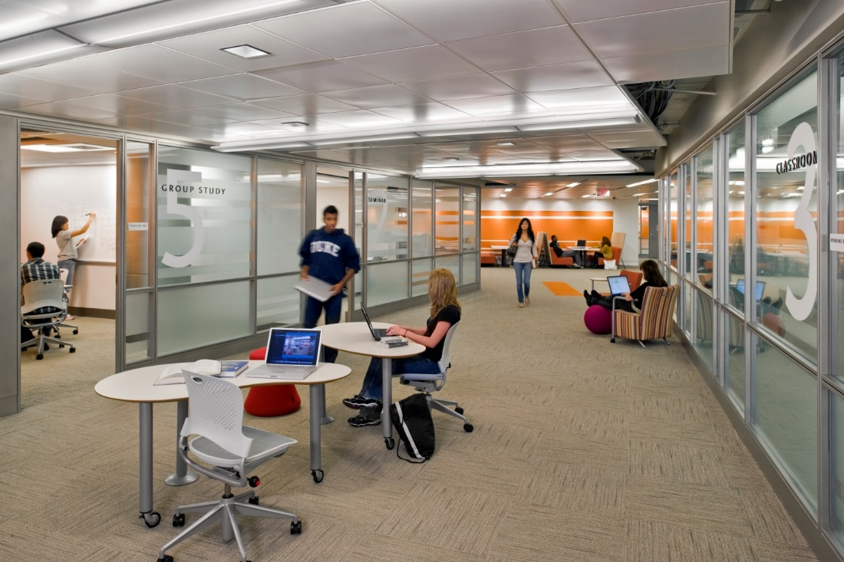

Slide 23
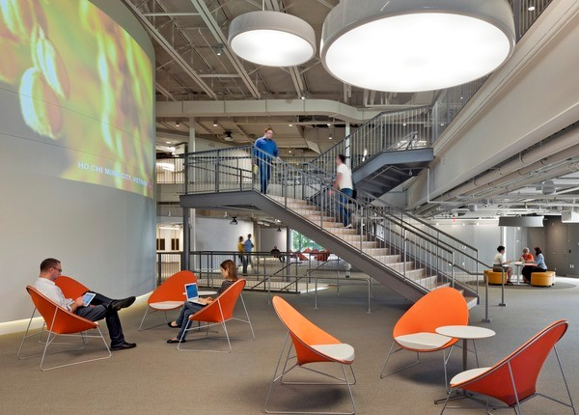

Slide 24
Fiat Lux Features
Technology rich
Innovative

Slide 25
21ST CENTURY STUDENTS:
SCHOLARSHIP IN A DIGITAL WORLD
Courtesy of NC State University

Slide 29
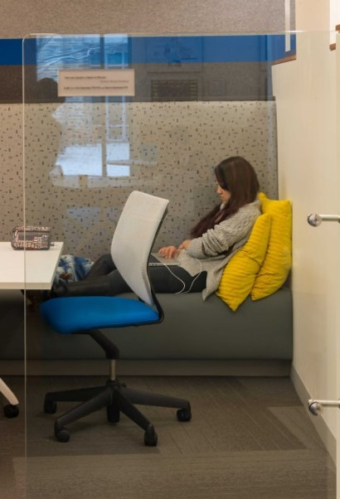
Quiet retreats

Slide 30
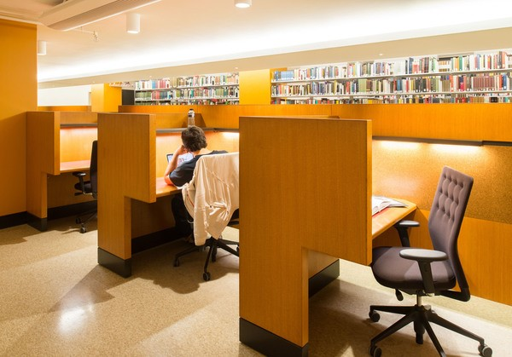

Slide 31
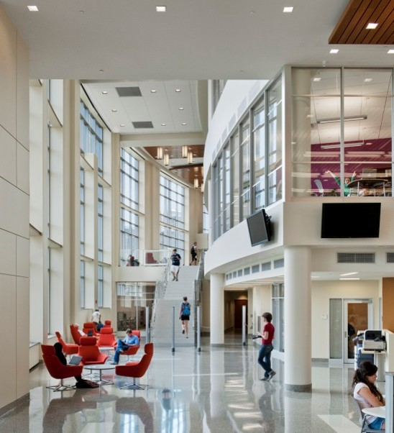

Slide 32
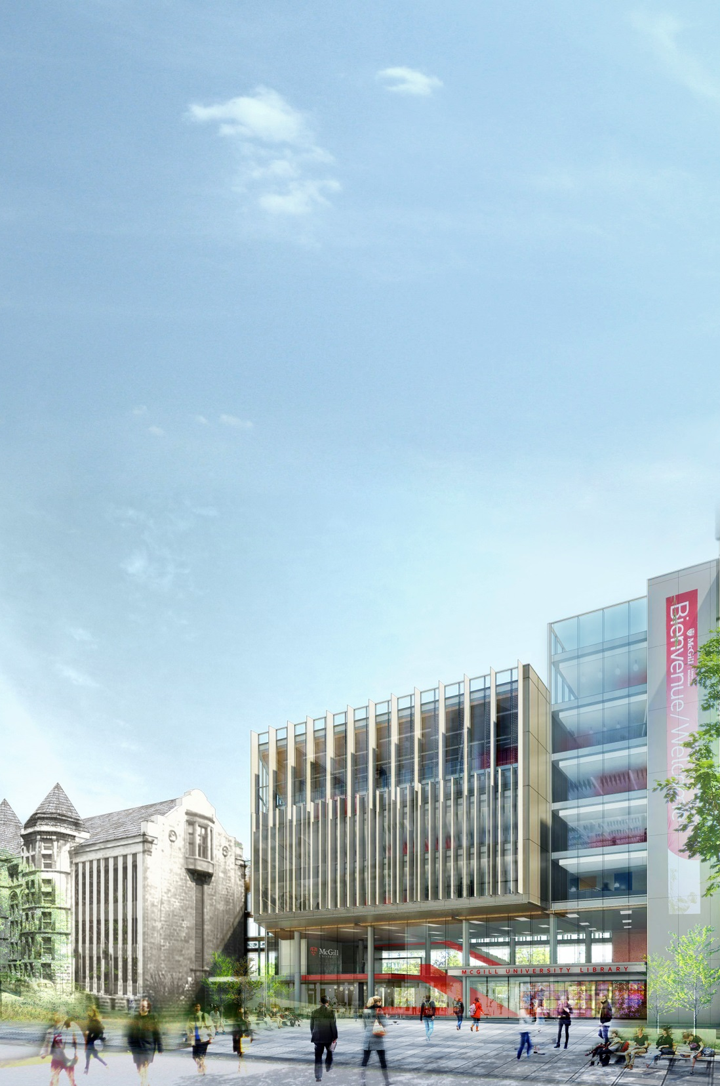
All renderings by ekm and Shepley-Bulfinch
VISION FOR THE FUTURE:
LIBRARY OF THE MID-21ST CENTURY

Slide 33
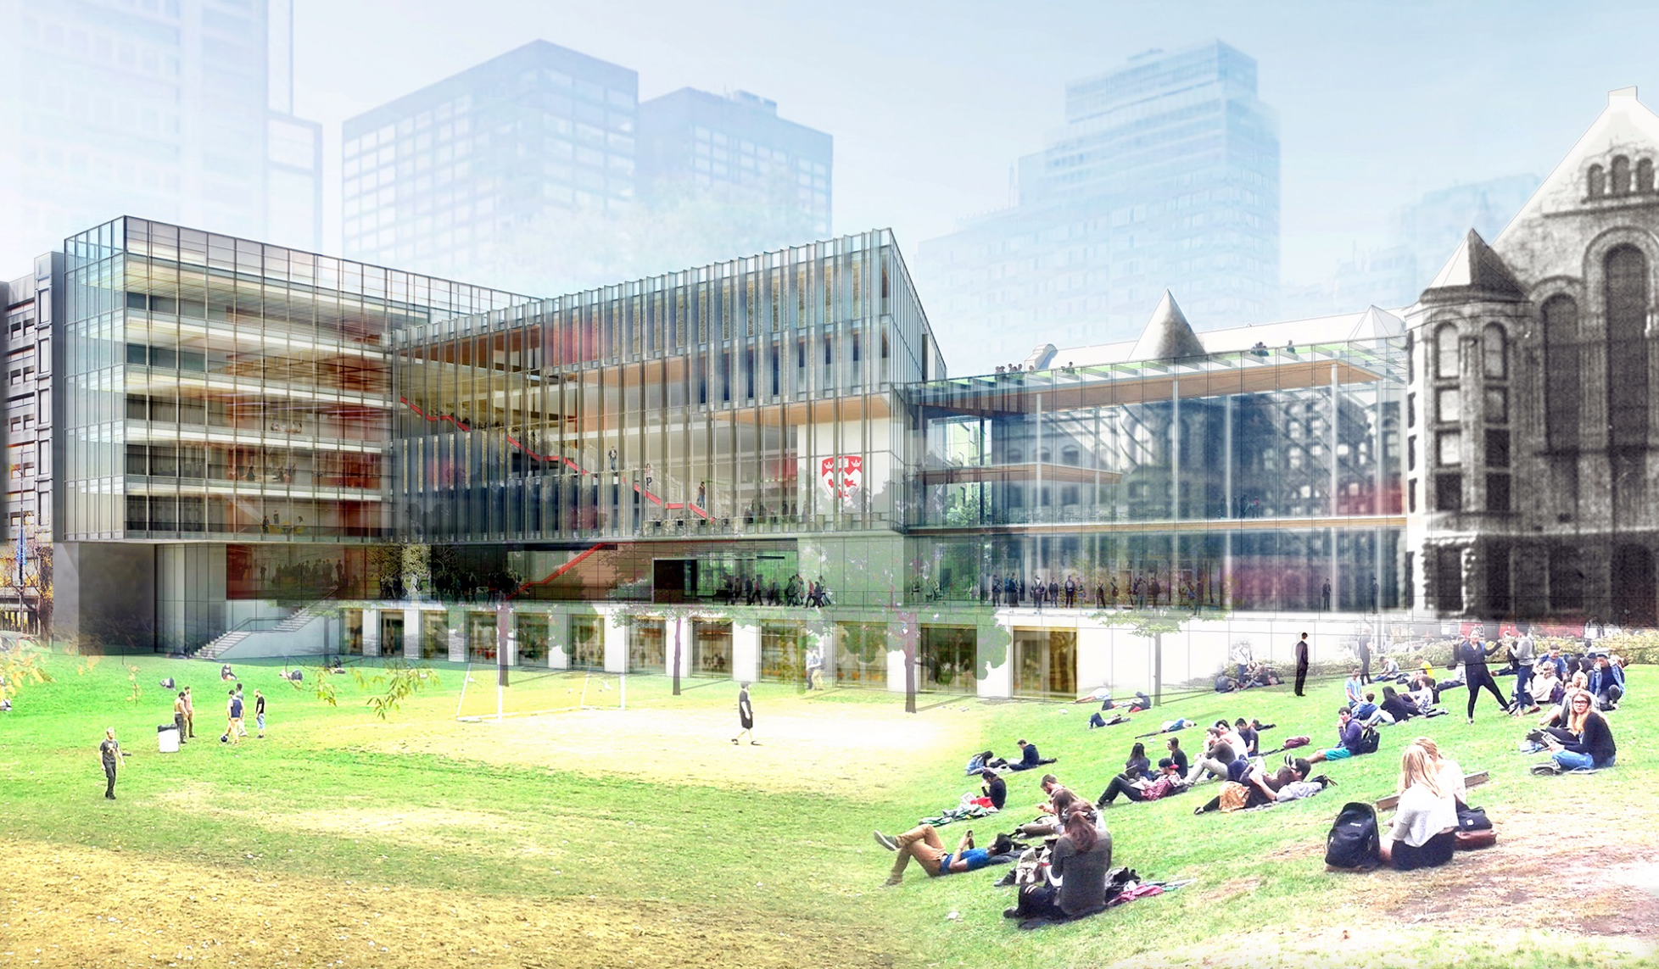
The reimagined Redpath Library Building will offer an inspirational facility that incorporates the best practices of the world’s leading academic libraries.

Slide 34
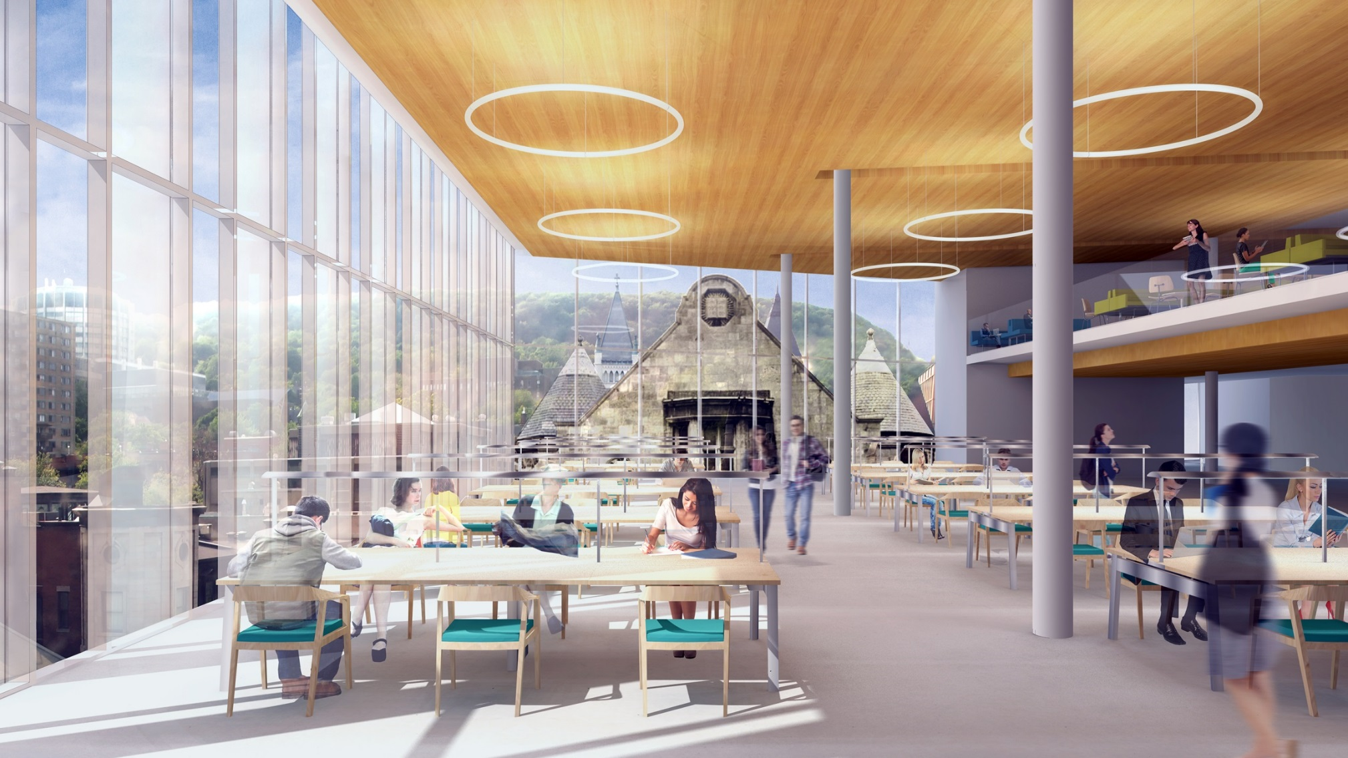
An iconic reading room on the top floor will offer stunning views of the McGill campus, downtown Montreal and nearby Mount Royal.

Slide 35
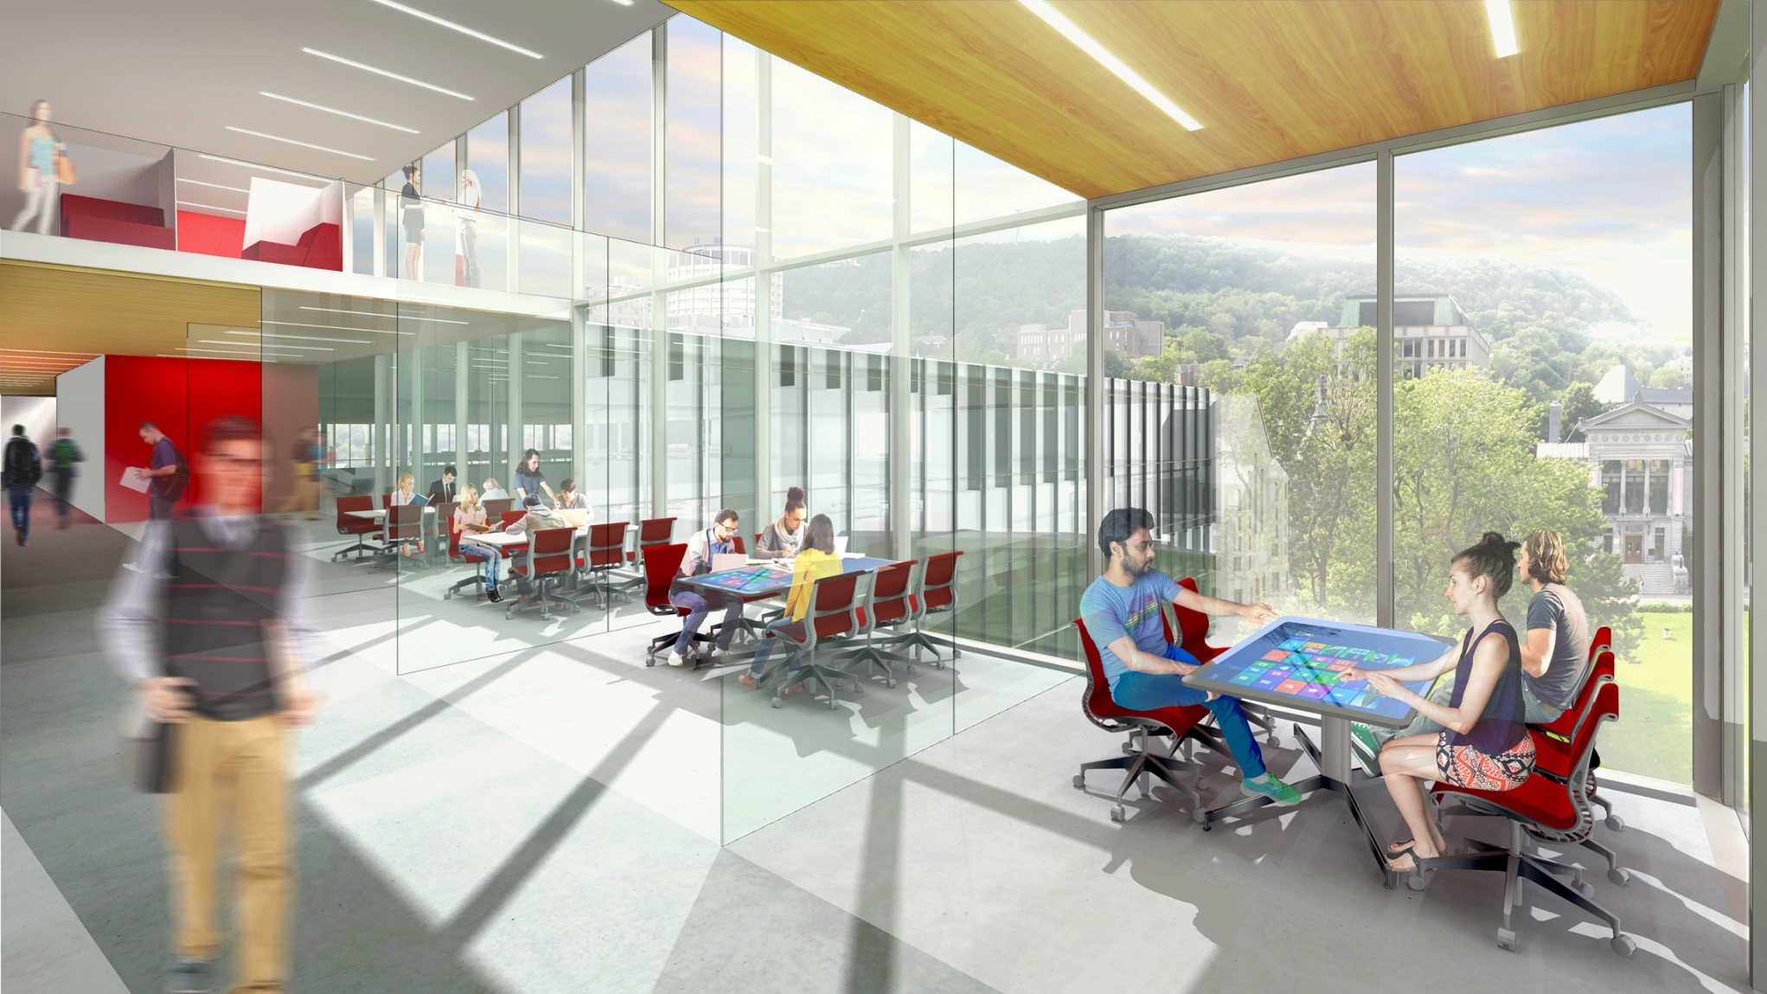
Floor space will be rededicated to state-of-the-art, technologically-enhanced solo and group study rooms.

Slide 36
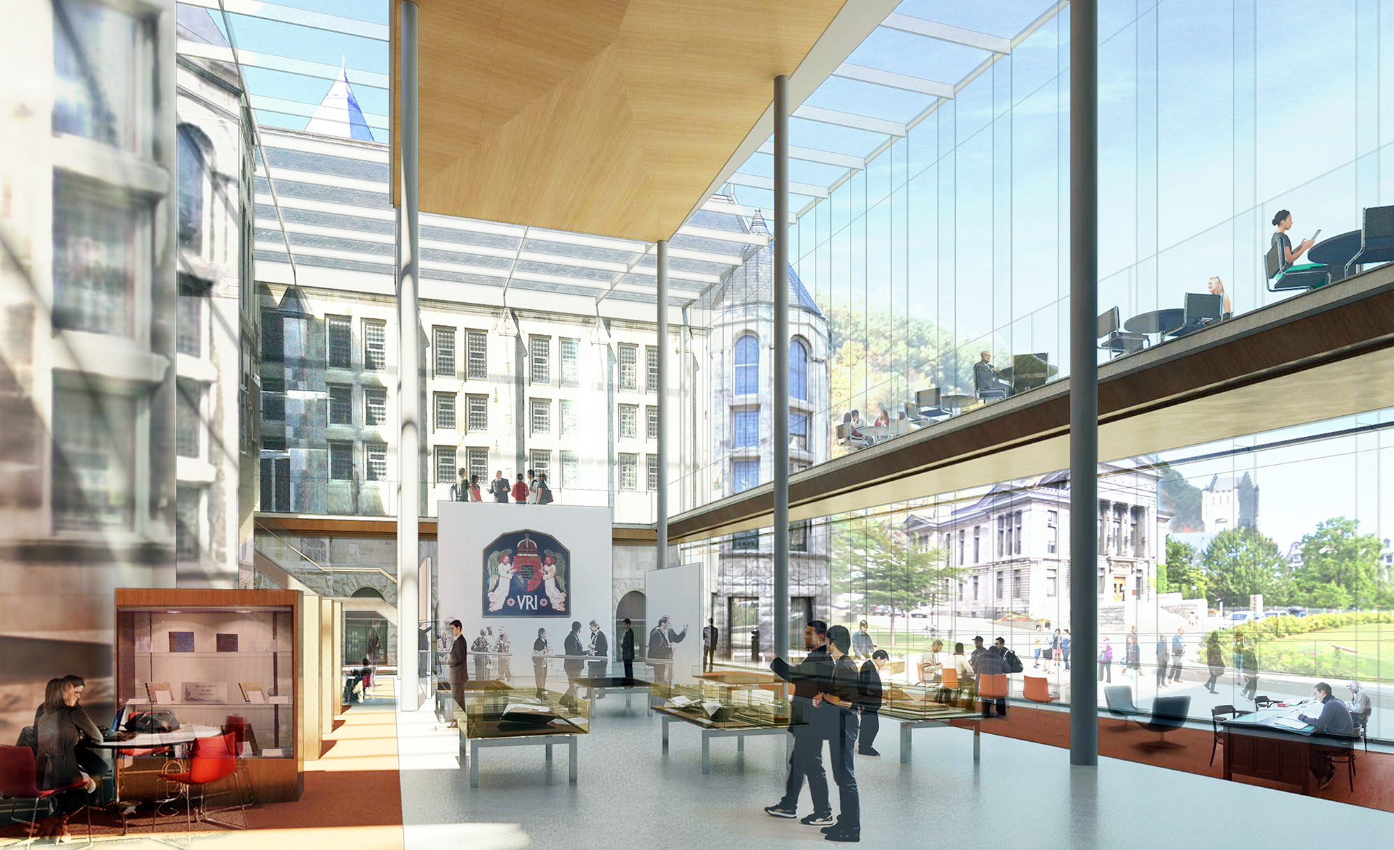
A signature event space will provide a stunning, sun-filled location that will benefit the entire McGill community.

Slide 37
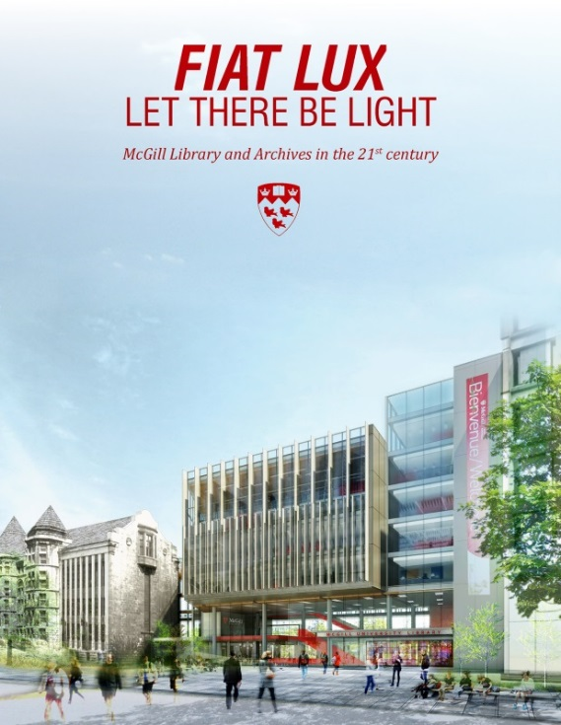
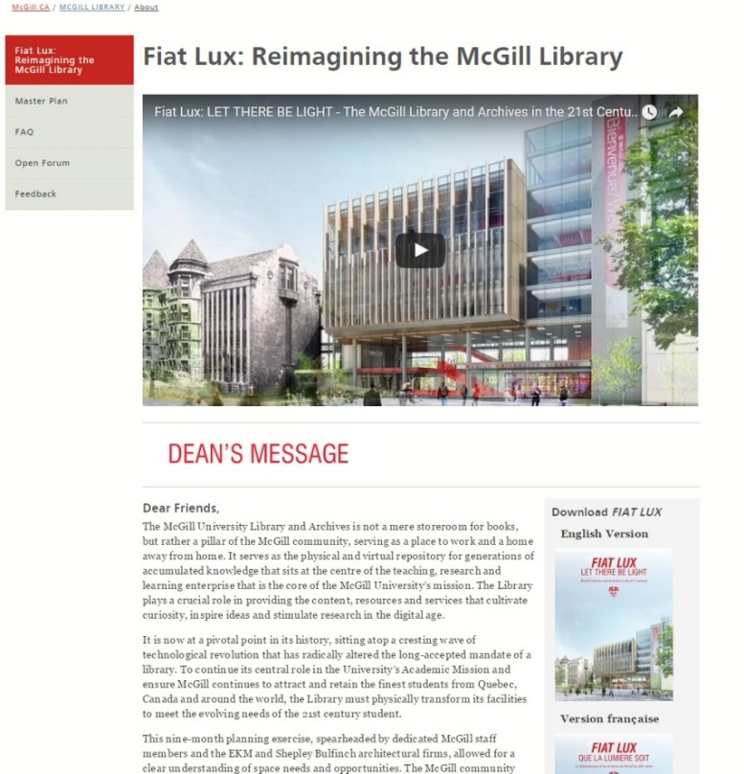
THANK YOU!
mcgill.ca/library/about/fiat-lux

