Slide 1
Report of the President to WINTER 2018 GA
Muna Tojiboeva President

Slide 2
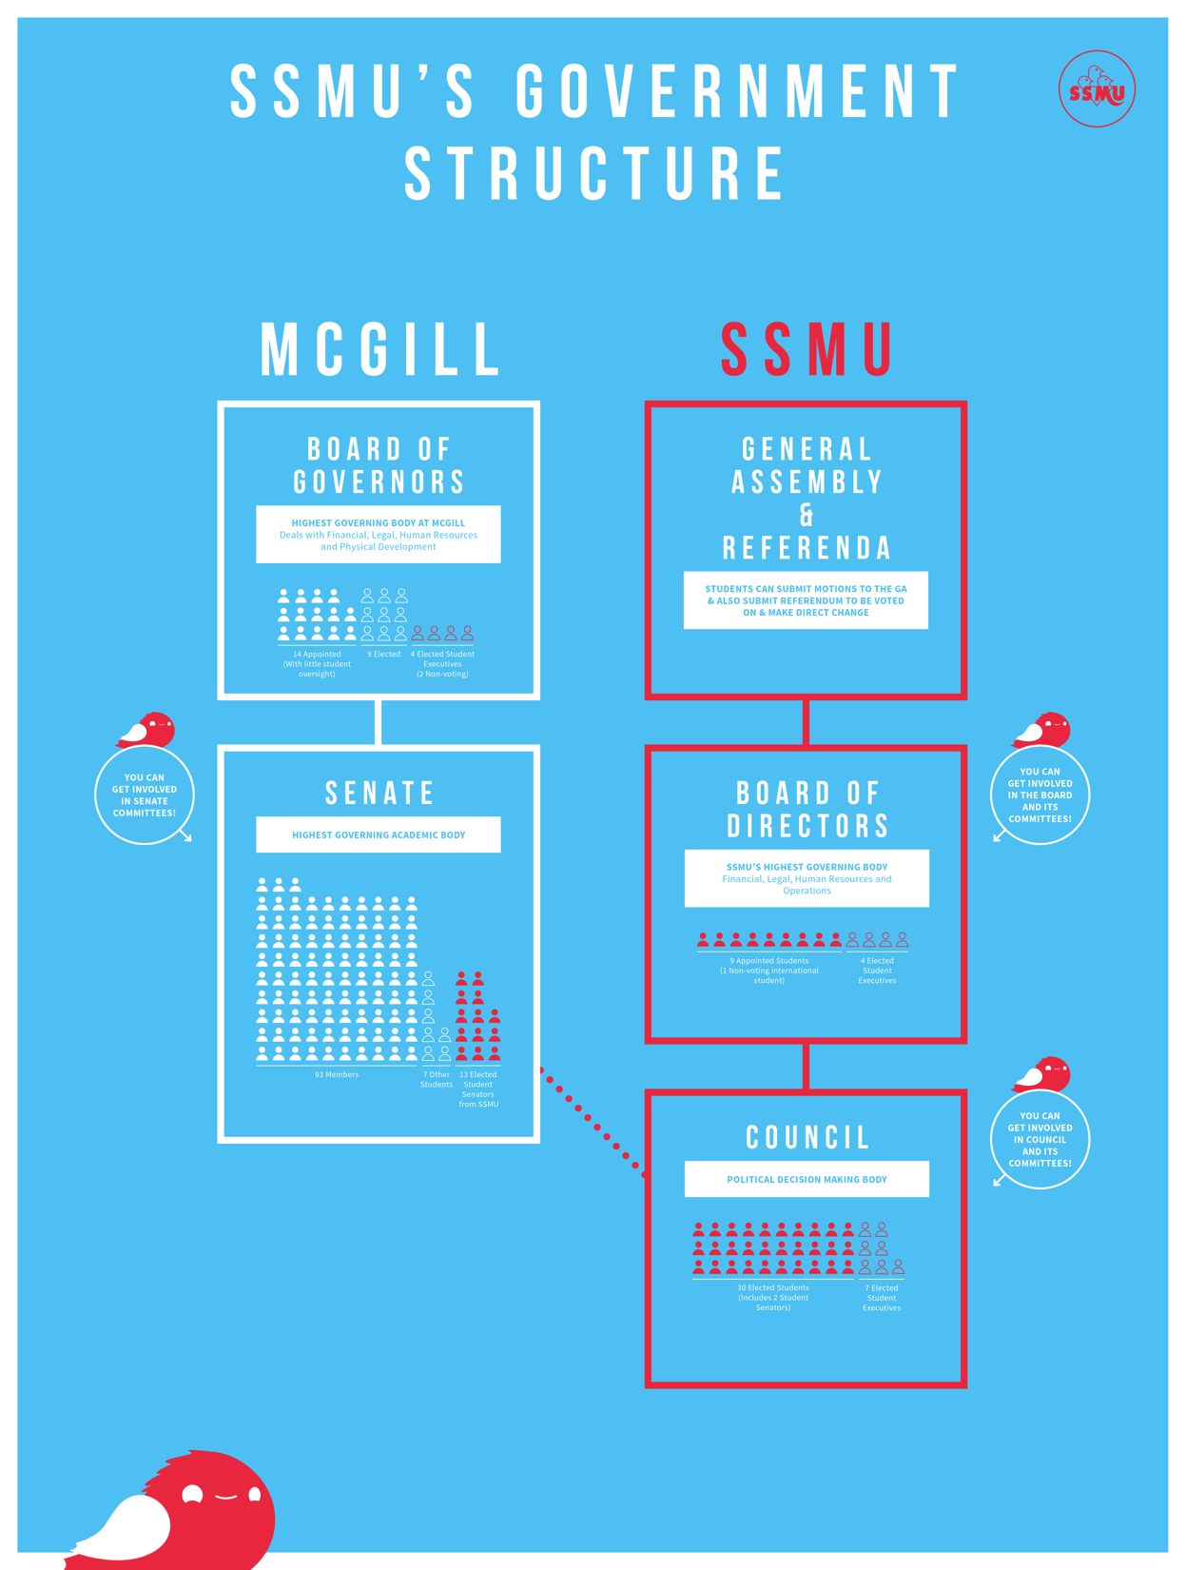
What Does the President Do?
PRESIDENT. The President shall exercise the following powers and perform the following duties: to be the chief officer and chief spokesperson of the Society; to ensure the long- term integrity of the Society; to enforce the Constitution and Internal Regulations of the Society and ensure the maintenance of the governance documents; to chair and coordinate the activities of the Executive Committee; to manage the Society's human resources; to call meetings of and set the agenda for the Legislative Council and the Board of Directors; to manage relations between the Society and the administration of McGill University; and to represent the Members on the University Senate and Board of Governors.
Section 10.11 of the Constitution

Slide 3
Board of Governors
I participate in Board of Governors meetings (committee, main BoG, or retreat meetings).
I sit on two BoG committees:
The Executive Committee
The Nominating, Governance, and Ethics Committee
I work with MCC to come up with Board Reform proposals.
I started the pre-Board of Governors meetings to ensure that more people can participate in the document review process and to ensure that the undergraduate voices are successfully represented.
Students’ Society of McGill University
3600 McTavish Street, Suite 1200, Montréal, Québec

Slide 4
Senate
I attend Senate Caucus meetings, held each Monday at 6:30PM (SSMU Boardroom).
Attend the MAUT Pre-Senate Lunches, which is a space for various university staff, professors, and student representatives to discuss the Senate documents ahead of the Senate meeting.
I attend all McGill Senate meetings.
I will be attending the next Senate meeting this upcoming Wednesday (March 28th, 2018).
At Senate Caucus before the next Board of Governors meeting, I will be presenting a short report prior to the BoG meeting to consult Senators.
After each BoG meeting, I plan on distributing my notes from the Board of Governors meeting so enable SSMU Representatives to discuss any points of interest at the Faculty Council level.
Students’ Society of McGill University
3600 McTavish Street, Suite 1200, Montréal, Québec

Slide 5
University Relations
Organized a Student-Board of Governors Open Forum
Currently negotiating the McGill-SSMU Memorandum of Agreement
Re-established a relationship of mutual trust and respect between the SSMU and members of the McGill Administration
Re-established SSMU’s presence on certain committees and began sitting on new university level committees (on which SSMU previously was not represented, please see President’s report from Fall 2017 for a list of ALL the new committees).
Students’ Society of McGill University
3600 McTavish Street, Suite 1200, Montréal, Québec

Slide 6
Projects
Francophone Affairs
International Students’ Affairs
Standardization of documents
Elections timelines and procedures
Institutional memory for student-staff
Handbook for incoming student-staff
Workplans
Students’ Society of McGill University
3600 McTavish Street, Suite 1200, Montréal, Québec

Slide 7
Projects
Spinyt – SSMU Eats App
Various MOAs: ECOLE and NUS MOAs with SSMU
Menstrual Hygiene Products
Judicial Board Internal Rules of Procedure
Board of Directors training and institutional memory
Bike Facility
Vending Machines at the SSMU post building closure
Students’ Society of McGill University
3600 McTavish Street, Suite 1200, Montréal, Québec

Slide 8
Questions?
514-398-6801
president@ssmu.ca
Office Hours:
Most days of the week, for at least 1 hour.
Please see website for the most up to date office hours (vary by date).
Students’ Society of McGill University
3600 McTavish Street, Suite 1200, Montréal, Québec

