Slide 1
Report of the Vice-President (External Affairs)
Winter General Assembly – 2017
Connor Spencer
March 26th, 2018

Slide 2
VP External Job Description and Mandates
•What is Under My Portfolio? : 1) Campaigns, 2) Indigenous Affairs, 3) Community Affairs, 4) External Affairs, 5) Union Affairs
•SSMU Constitution 10.14: “The Vice-President (External Affairs) shall exercise the following powers and perform the following duties:
to represent the Society and communicate positions and Policy taken by the Society to external bodies and agencies;
to lobby federal, provincial, and municipal governments to further the objectives, goals and Policy of the Society;
to mobilize students on positions and Policy of the Society and assist in the coordination of student-run political campaigns;
to develop Policy regarding initiatives in the Montreal community;
to communicate to the Board of Directors relevant external issues which may significantly affect the Society;
to coordinate the Society’s Indigenous solidarity efforts;
to operationalize the Society’s commitment to the Francophone community;
and to attend meetings of relevant local, provincial, national or international student groups.

Slide 3
Mandates
(Full mandate letter available here: https://docs.google.com/a/ssmu.ca/document/d/1ohMWClmYkn9tlP8yENIYvCZvdUfD3QNML0vCDzjxRu4/edit?usp=sharing )
Policies:
•Indigenous Solidarity Policy
•Policy Against Unpaid Internships
•Policy for a Campus Free of Harmful Military Technology
•Policy on Support for Family Care
•Sustainability Policy
•Climate Change Policy

Slide 4
Campaigns
Supervision of the Campaign Coordinators
Official SSMU Campaigns: McGill Against Austerity, Divest McGill, Demilitarize McGill
Our Turn: a National Student-Led Strategy to End Campus Sexual Violence
McGill Solidarity Action Network
Updating Discover McGill Website
Resources on new External Affairs Website
Supervision of Austerity Measures Researcher
Co-supervision of Harmful Military Technology Researcher

Slide 5
Indigenous Affairs
Supervision of Indigenous Affairs Commissioner
Indigeneity and Solidarity Event Series
Helped out with the Walk-Out
Looking into Redmen name
Guide for Settler Students

Slide 6
Community Affairs
Supervision of Community Affairs Commissioner
Working with UTILE and PGSS to look into affordable student housing options for McGill students after results of UTILE’s PHARE survey
Trash2Treasure – Sustainable Project Initiative to deal with waste created in Milton-Parc on move-out day
Waste disposal awareness campaign for student residents of Milton-Parc
Presenting at Milton-Parc GA tomorrow to strategize on relations

Slide 7
External Affairs
Provincial Representation – Observation at both UEQ and AVEQ’s tables
Co-Chair of the Adhoc Committee on Provincial Representation
Social Justice Days and Culture Shock with QPIRG
Bill 151

Slide 8
Other
SSMU Gendered and Sexualized Violence Policy
Governance Document Working Group // Committee
Implementation Committee (McGill Policy Against Sexual Violence)
Working with the Environment Commissioners
External Affairs Website

Slide 9
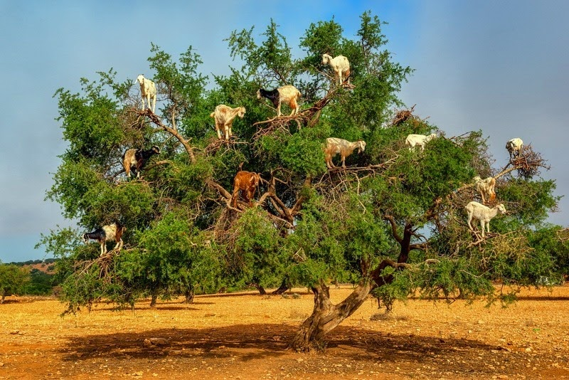
Questions?

