Slide 1
FIAT LUX LIBRARY PROJECT Colleen Cook, Trenholme Dean of Libraries Presented to SSMU Executive Council February 27, 2020

Slide 2
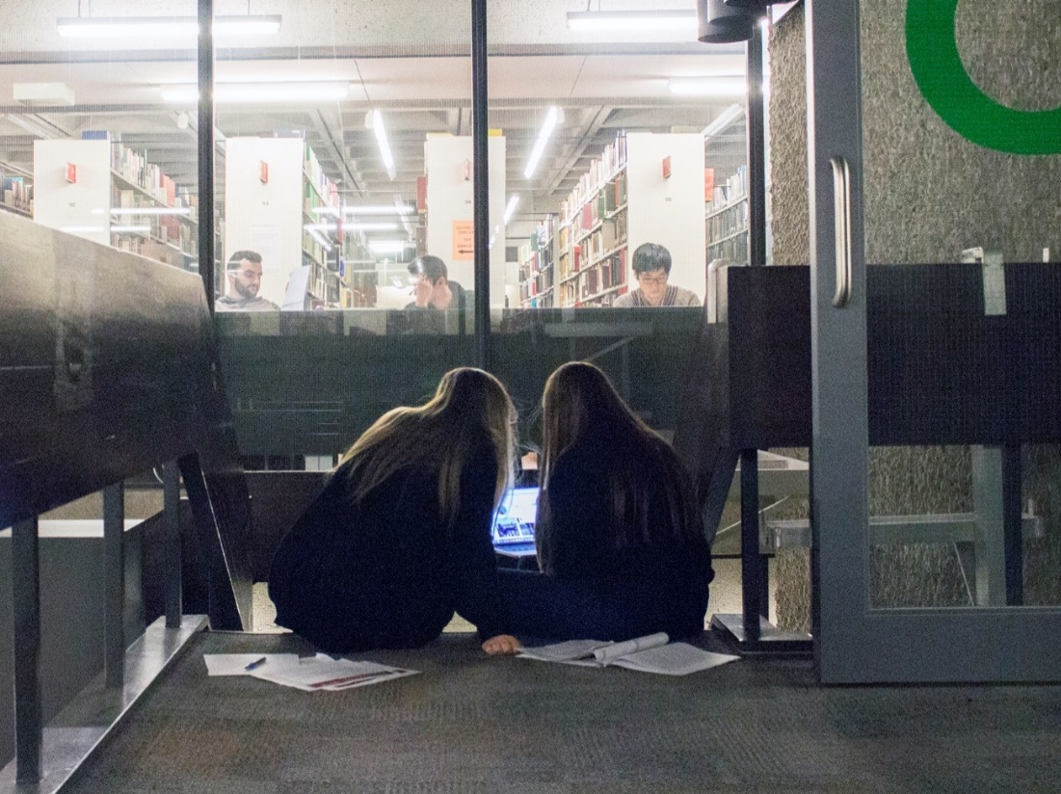
Solving the Library’s space challenge

Slide 3
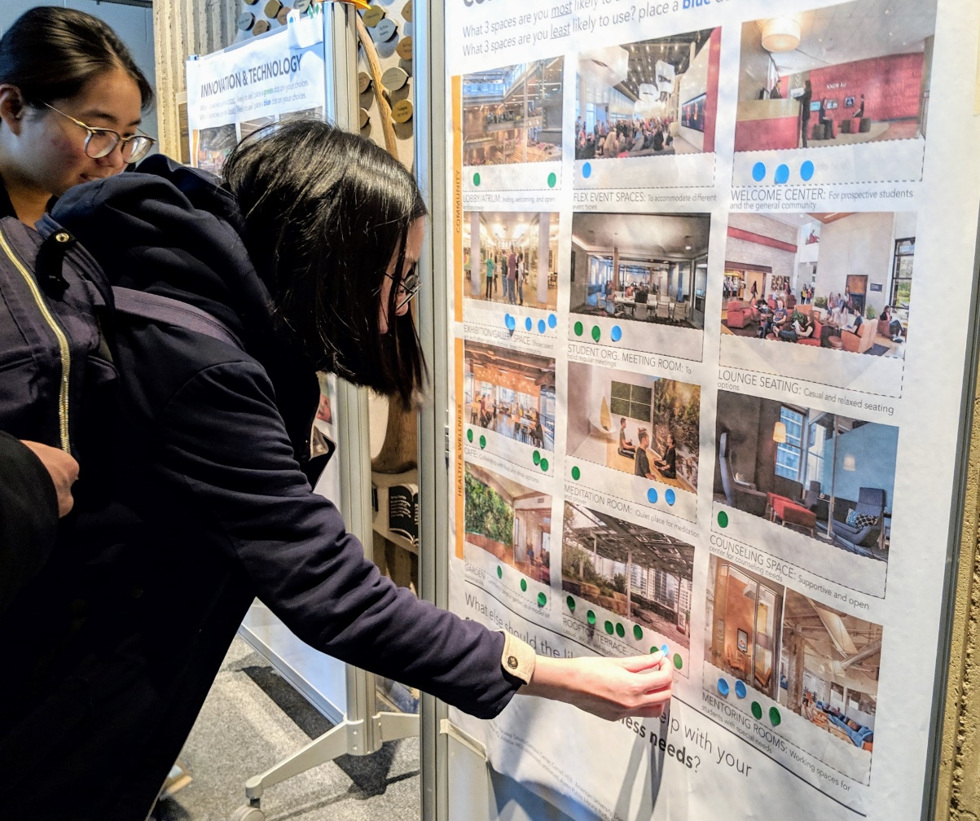
Consulting the community
Governance & working committees
Focus groups
Surveys
Tour of peer institutions
Town Hall & Open Forum
Symposium on the future of libraries
Feedback Fairs
One-on-one interviews

Slide 4
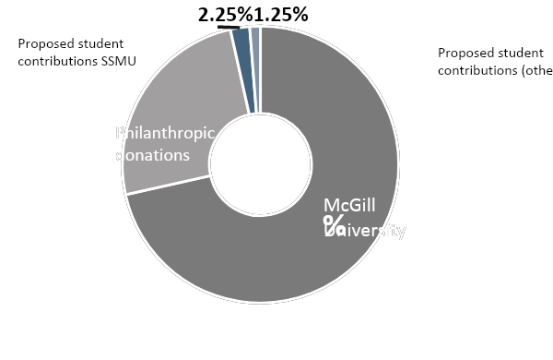
Your dollar will go a long way
85% of daily visits are from undergrads*
*Library Census Day 2018

Slide 5
Help us reimagine the Library
Proposed Contribution by Student Group | # students | % of student population | Per semester fee | Yearly with possible 30% opt-out | Total over 10 years
SSMU Undergraduates | 24,289 | 64% | 13.27 | $ 451,241 | $ 4,512,407
Macdonald Undergraduates | 1,263 | 3% | 13.27 | $ 23,464 | $ 234,640
Continuing Studies | 2,843 | 8% | 13.27 | $ 52,817 | $ 528,172
PGSS | 9,284 | 25% | 13.27 | $ 172,478 | $ 1,724,780
Totals | 37,679 | 100% |  | $ 700,000 | $ 7,000,000

Slide 6
Moving forward
2019
Fiat Lux Playbook & Exec Director hired
2020
Preliminary design begins
2022
Schulich reopens
2023
Groundbreaking & phased implementation (approx. 3 years)

Slide 7
Resolution for Approval
Do you agree to the creation of the opt-outable $13.27 SSMU Fiat Lux Library Project Fee, per semester, payable by all full-time and part-time SSMU members, to start in Fall 2020 and to be charged until Winter 2030 (inclusive)?

Slide 8
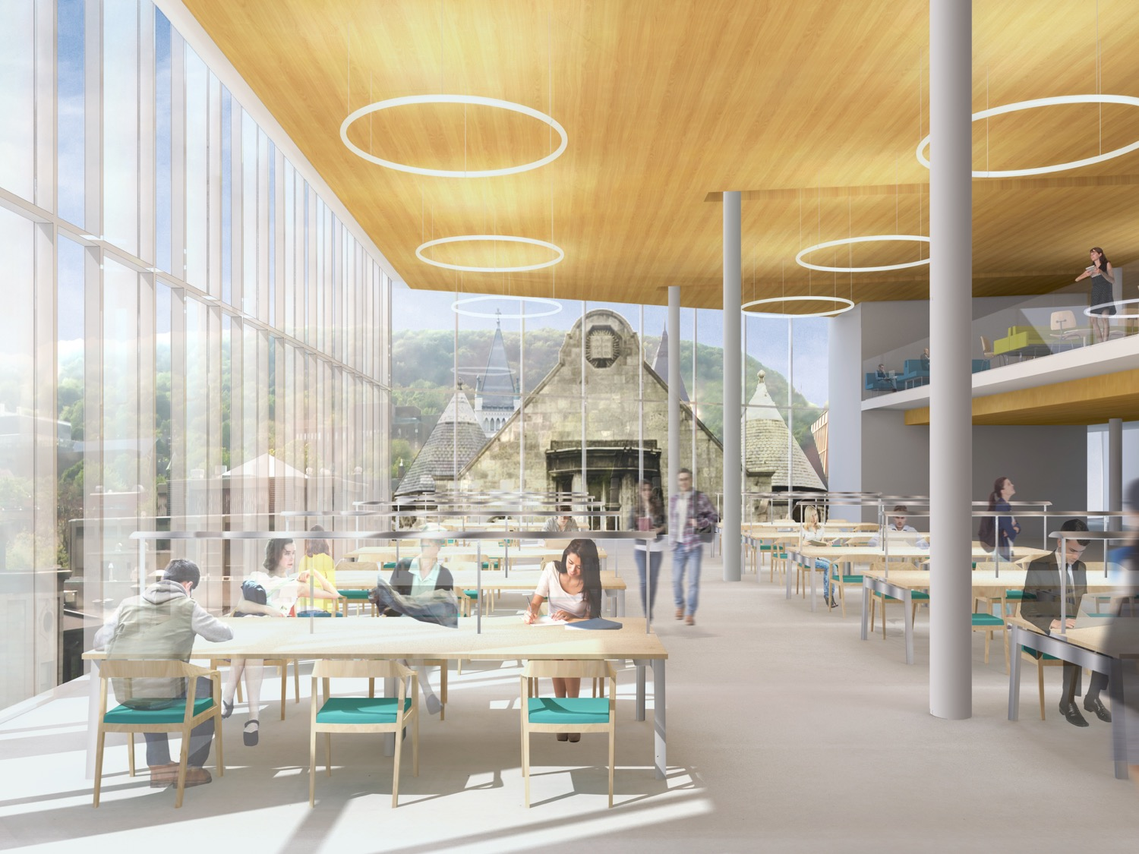
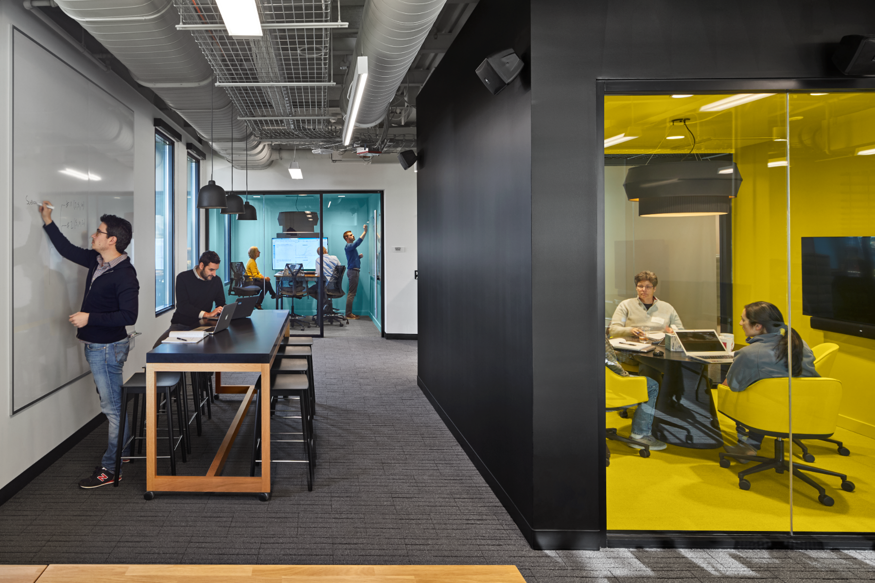
Help us reimagine the Library
CREDIT: PAGLIUCA HARVARD LIFE LAB, HARVARD UNIVERSITY
©ROBERT BENSON PHOTOGRAPHY. COURTESY: SHEPLEY BULFINCH
Thank you!

