Slide 1
Report of the Vice-President (University Affairs)
Fall 2020 General Assembly - Brooklyn Frizzle

Slide 2
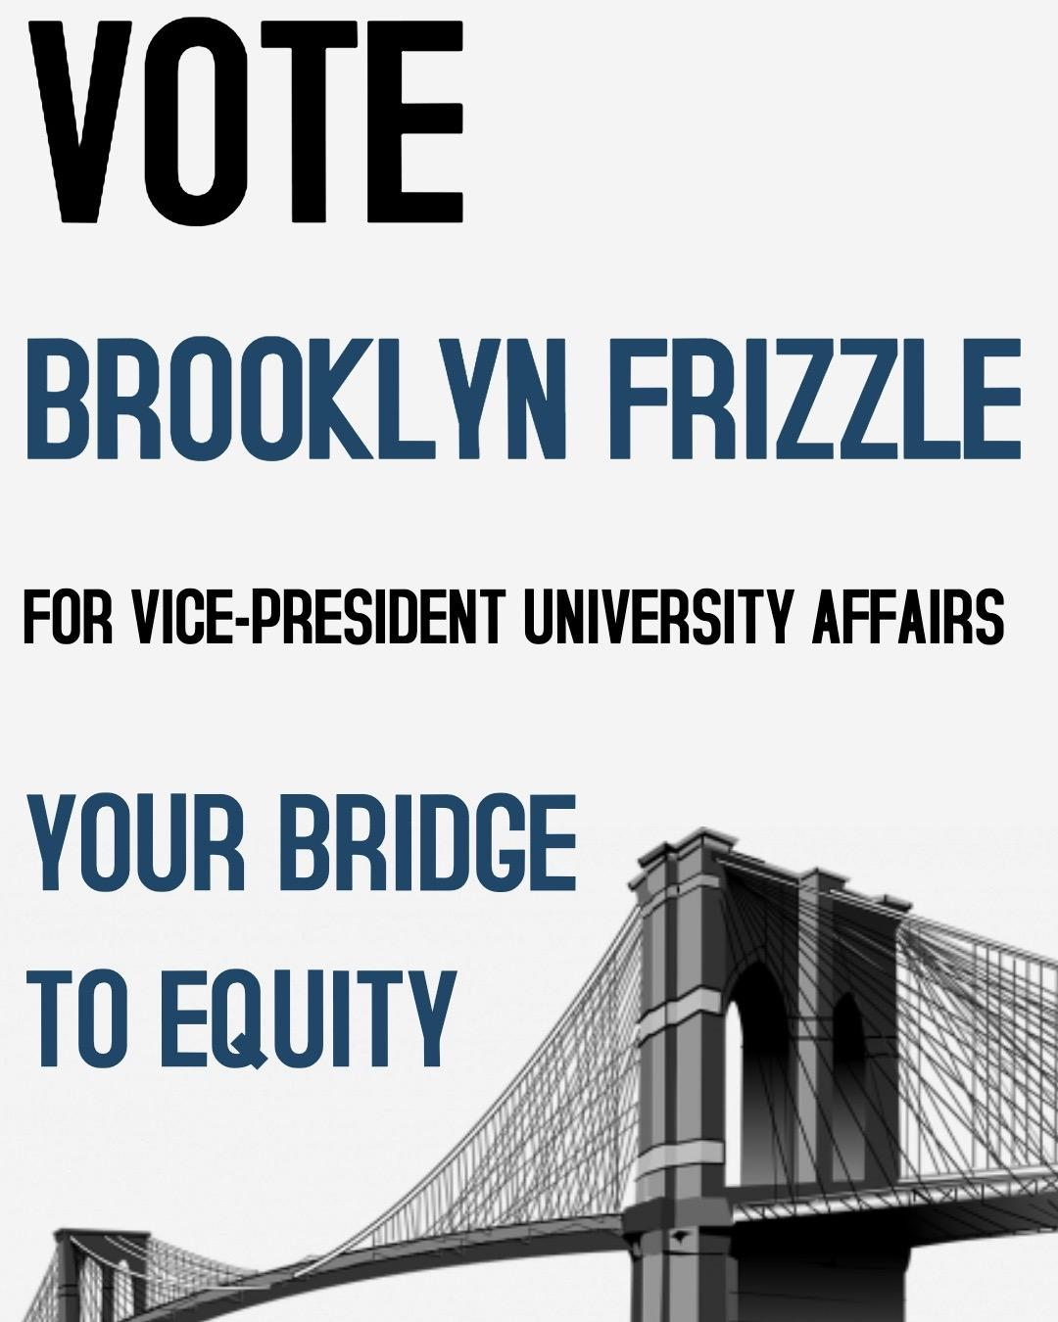
Remember this?

Slide 3
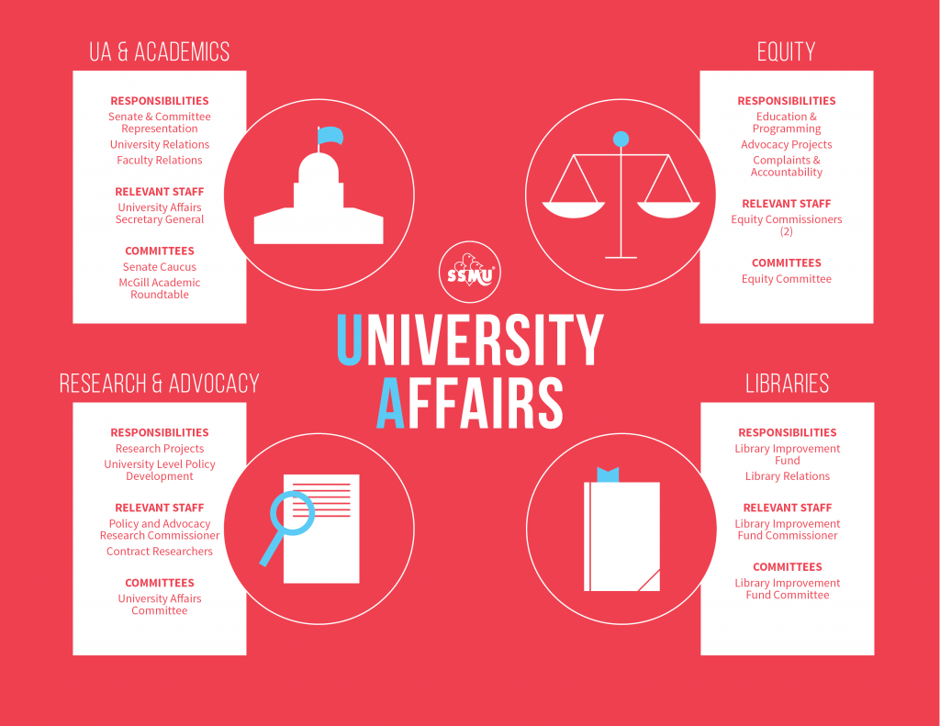
moved to the External portfolio→
doesn’t exist →
now called the SRRAC →
doesn’t exist →

Slide 5
The New-A
Portfolio
University Affairs & Research
Equity & Advocacy
Academic Resources

Slide 6
University Affairs & Research
Responsibilities
Undergraduate Senate and Committee representation
Support and training for Senate Caucus
Student Rights and the Know Your Rights campaign
University relations and student representation
University-level accountability
University-level policy review and development
Research and advocacy projects

Slide 7
University Affairs & Research
Relevant Staff
University Affairs Secretary-General
Student Rights Researcher and Advocacy Commissioner
Students from Care Project Assistant
Special Researchers

Slide 8
University Affairs & Research
Committees
SSMU-MCSS Senate Caucus
Senate Steering Committee (McGill)
Senate Nominating Committee (McGill)
Scholarship Review Subcommittee (McGill)
Committee on Student Services (McGill)

Slide 9
Equity & Advocacy
Responsibilities
Black Affairs, Francophone Affairs, and Indigenous Affairs portfolios
Anti-Sexual Violence mobilization, advocacy, and educational programming
Equity complaints and accountability
Institutional advocacy, mobilization, and policy development
Equity education and programming on campus
Menstrual Hygiene Product project

Slide 10
Equity & Advocacy
Relevant Staff
Anti-Sexual Violence Mobilization and Advocacy Commissioner
Black Affairs Commissioner
Equity Commissioners (2)
Commissaire aux affaires francophones
Indigenous Affairs Commissioner
Menstrual Hygiene Product Coordinators (1-3)

Slide 11
Equity & Advocacy
Committees
Black Affairs Committee
Board Ad-hoc Committee on Naming
Comprehensive Governance Review Committee
Equity Committee
Francophone Affairs Committee
Indigenous Affairs Committee

Slide 12
Academic Resources
Responsibilities
Library development and Library Improvement Fund
Study spaces and physical development
Academic accessibility
Open Educational Resources (OER) project
Library relations
Relevant Staff
Library Improvement Fund Commissioner
Open Educational Resource Commissioner
Open Educational Resource Assistants (1-2)
Committees
Library Improvement Fund Committee

Slide 13
University Affairs
Direct Supervision
Loose Collaboration
Indigenous Affairs Committee
Indigenous Affairs Commissioner
Vice-President (University Affairs)
Black Affairs Commissioner
Black Affairs Committee
Library Improvement Fund Commissioner
Open Educational Resources Coordinator
Student Rights Researcher & Advocacy Commissioner
University Affairs Secretary-General
Equity Commissioners
Menstrual Hygiene Product Coordinators
Library Improvement Fund Committee
Open Educational Resources Assistants
Special Researchers
SSMU Senate Caucus (13+ Senators)
Equity Committee

Slide 14
My work so far…
Accessibility &
Building our
Capacity

Slide 15
Social Accessibility
Employment Equity
Rewriting the SSMU Human Resources Policy
Resolving the Dayforce deadnaming problem
Compensating Legislative Councillors and Student Senators
Open Educational Resources
Free digital coursepacks
McGill Study Hubs and Printing Hubs
Campus Advocacy
Reviewing the Policy on Harassment & Discrimination
Overhauling the University Student Assessment Policy
Challenging and redefining Academic Freedom
Social Justice
Banning tone policing
Advocating for Harm Reduction
Special Researchers
Francophone Academic Rights Researcher
Preferred Names Use (IT & Wellness Hub)
Student Health & Wellness (Wellness Hub)
Academic Accessibility & Accommodations (OSD)

Slide 16
Building Capacity for Advocacy
Insti-SSMU-tional Advocacy
Establishing Black Affairs Commissioner & Committee
Implementing Equity Triages across SSMU Departments
Founding the Board Ad-hoc Committee on Naming (BACoN)
Improving accountability of the SSMU Nominating Committee
Open Educational Resources
Revamping SSMU OER and the #textbookbroke campaign
OER Coordinator and Master Plan
Student Textbook Experience Survey
Research
Releasing the first-ever SSMU Researcher’s Guide
Shifting to secure survey platforms & data storage
Overhauling SSMU research ethics
Senate Caucus
Drafting the first-ever Senators’ Guidebook
Amending the Constitution and IRs of Representation & Advocacy
Formalizing and empowering Senate Caucus
Reviewing Senate Membership and the University Statutes

Slide 17
Questions? Comments?
Concerns?

